Slide 1
Discrete Adiabatic Quantum Linear-system Solver
vhaktyr
2024/6/1

Slide 2
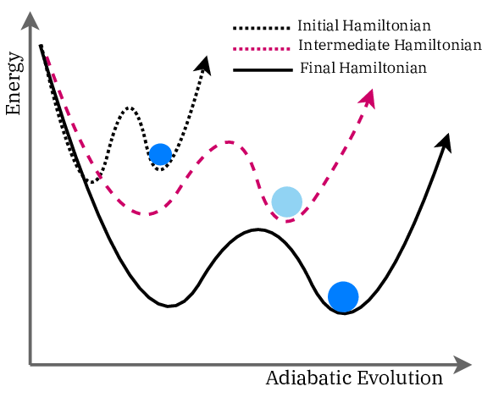
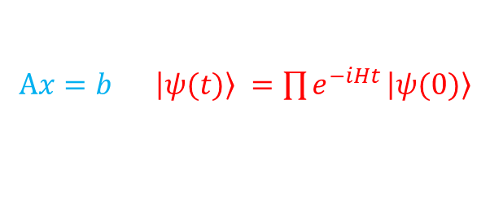
Index
https://www.researchgate.net/figure/Graphical-representation-of-quantum-annealing_fig2_351810686
Linear-system Solver via Adiabatic Evolution
Preliminary
Time Evolution & Adiabatic Evolution
Adiabatic Linear Solver
Hamiltonian Simulation
Block Encoding
Schedule Function & Randomization Method
Eigenvalue Filtering
Solutions to the Contest Problem
Block Encoding
Linear Solver
Rethinkings
$Ax=b$ $⇒$ $\left|ψ(t)\right\rangle =\prod{e^{−iHt}}⁡\left|ψ(0)\right\rangle$

Slide 3
Linear-system Solver via Adiabatic Evolution
Part 1

Slide 4
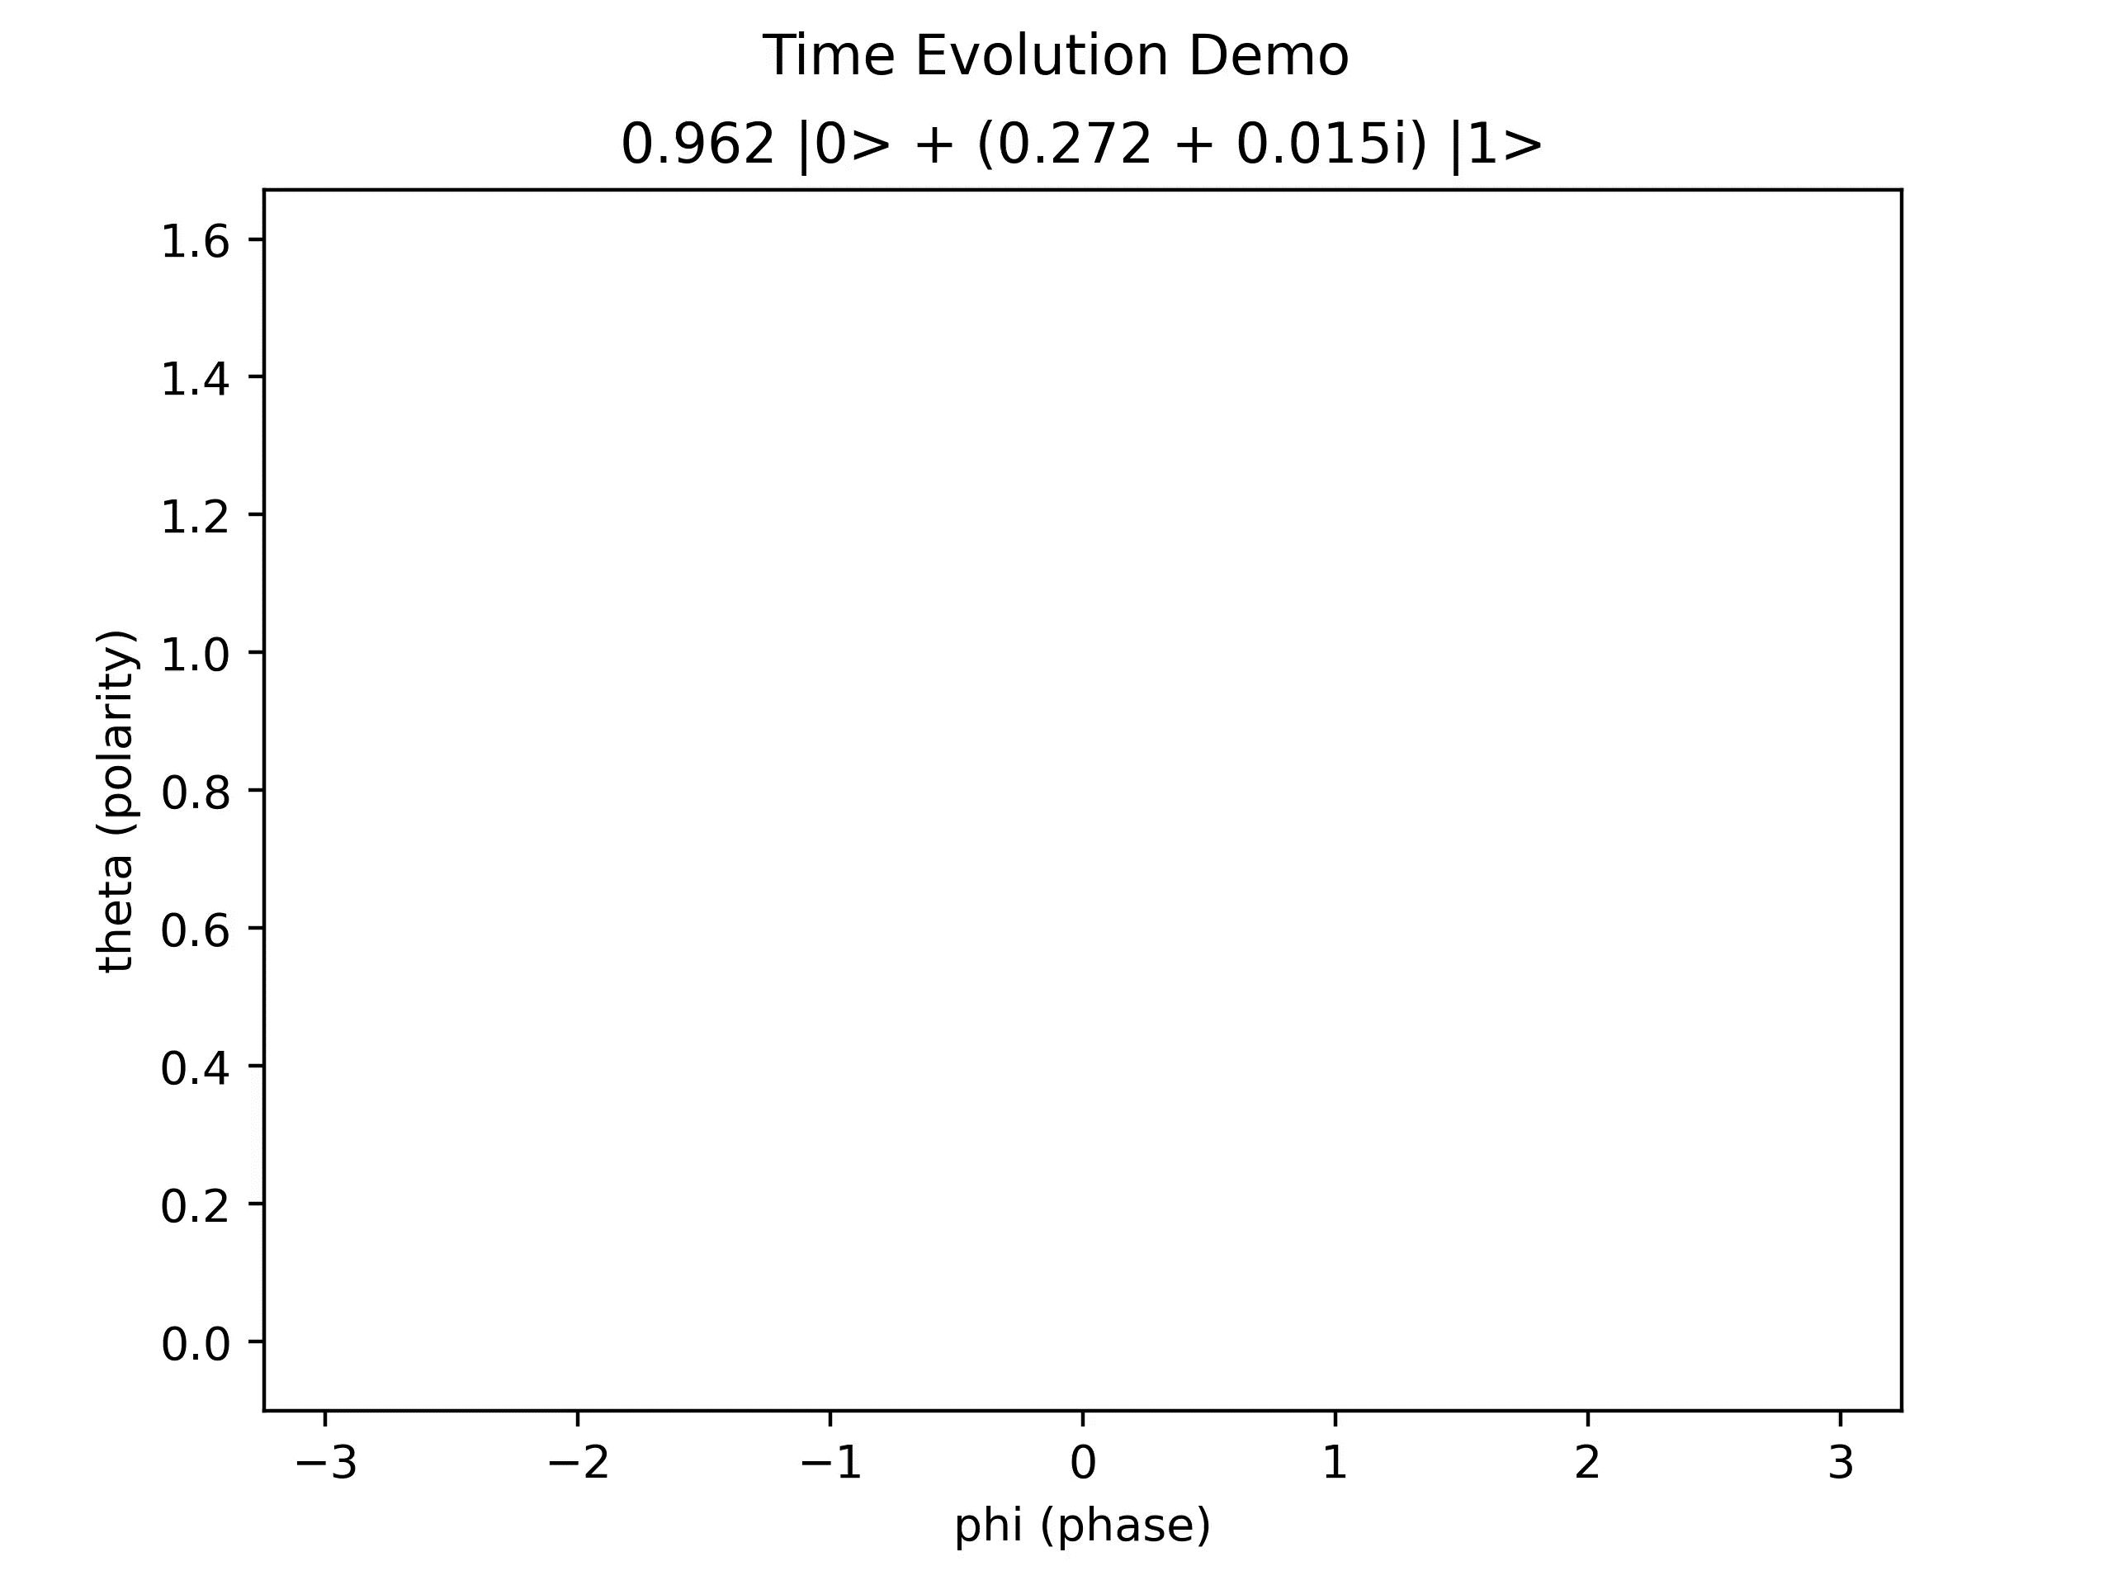
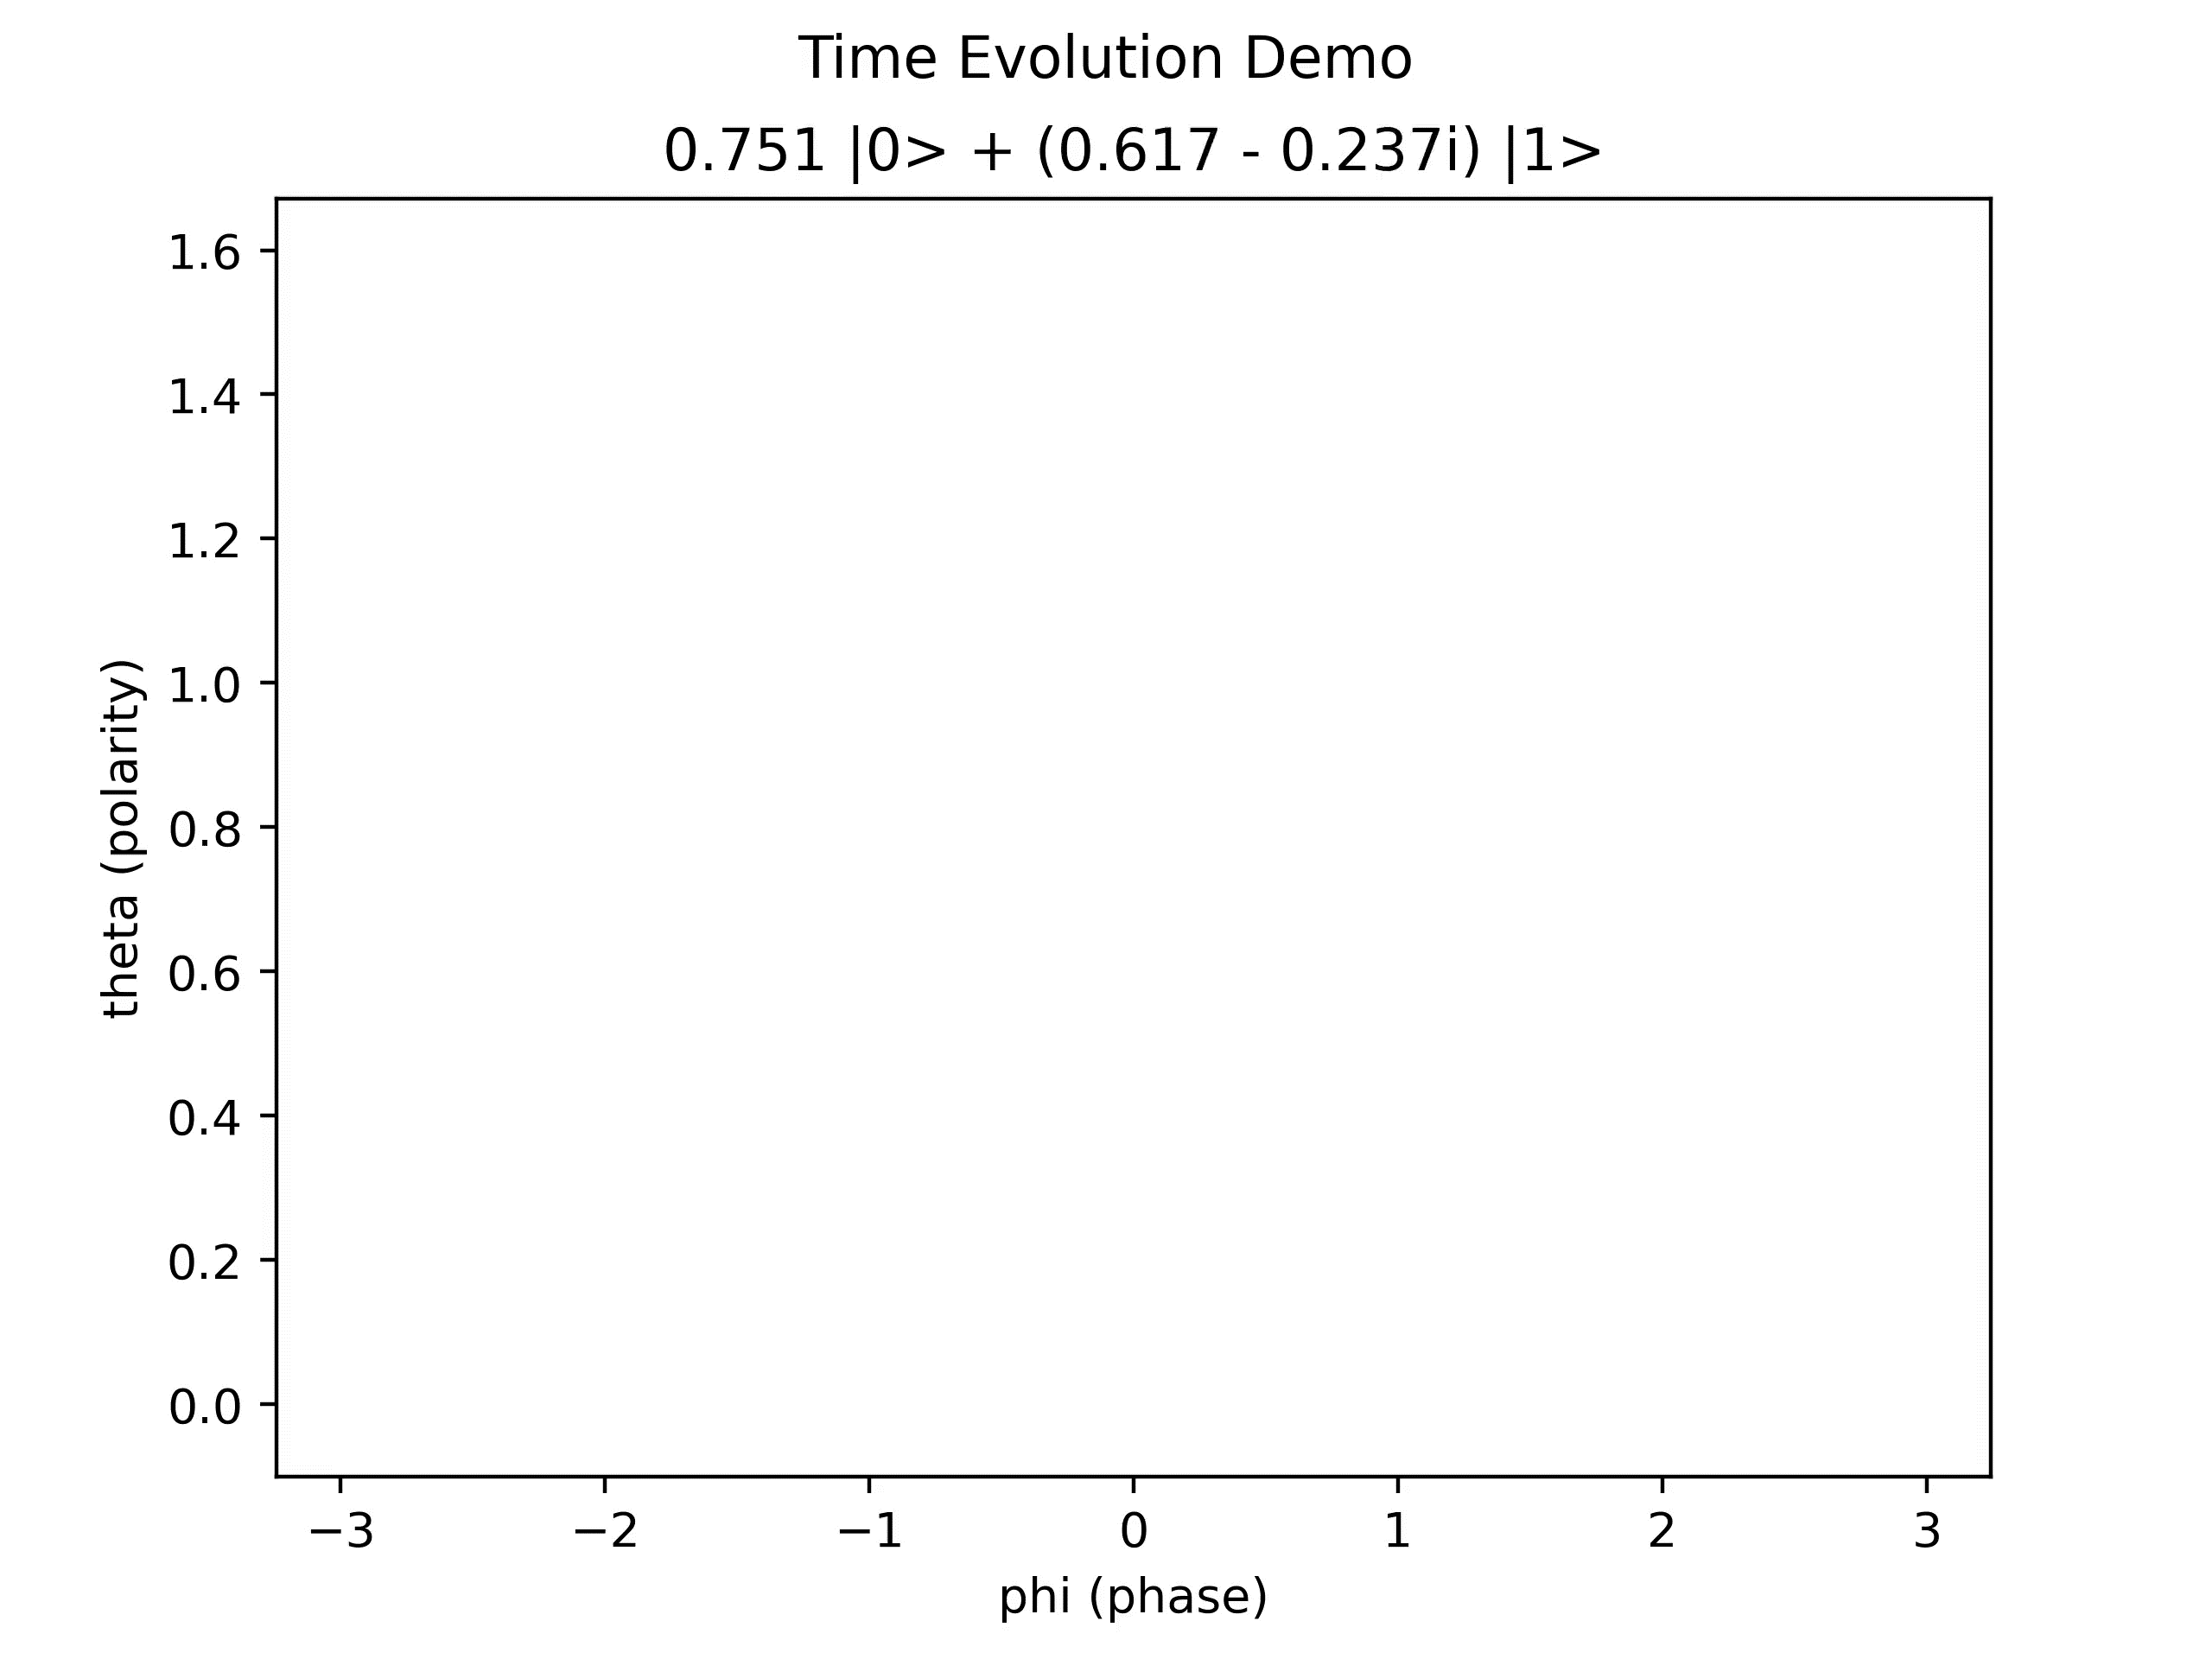
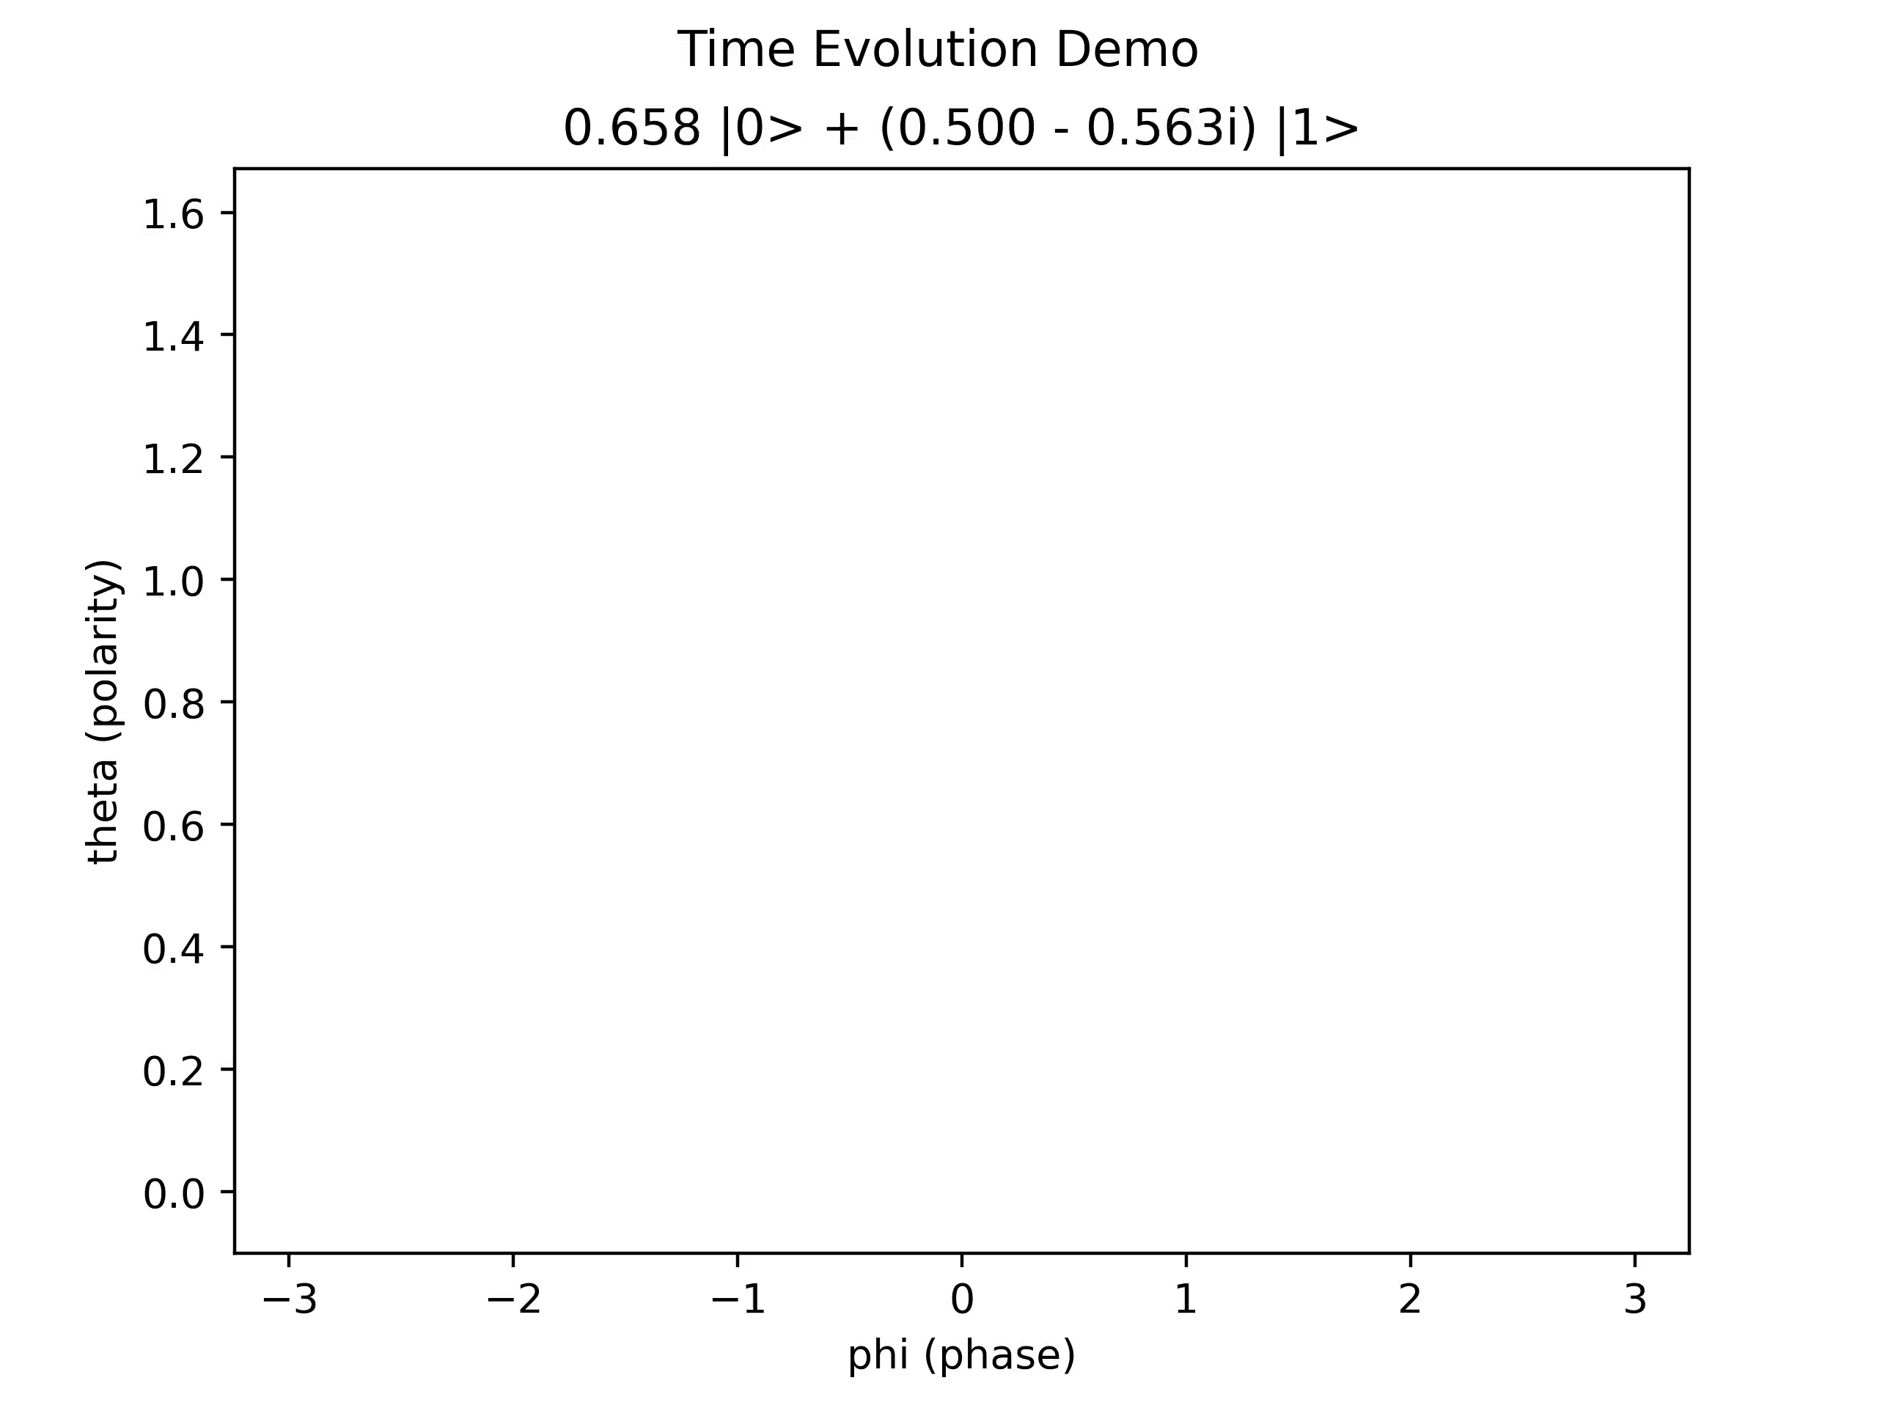

Time Evolution
A system with time-independent Hamiltonian H and initial state $\left|ψ(0)\right\rangle$, the evolution is given by
$$\left|ψ(t)\right\rangle =e^{−iHt}⁡\left|ψ(0)\right\rangle$$
Eigen state
Non-eigen state
Notes:
https://en.wikipedia.org/wiki/Time_evolution

Slide 5
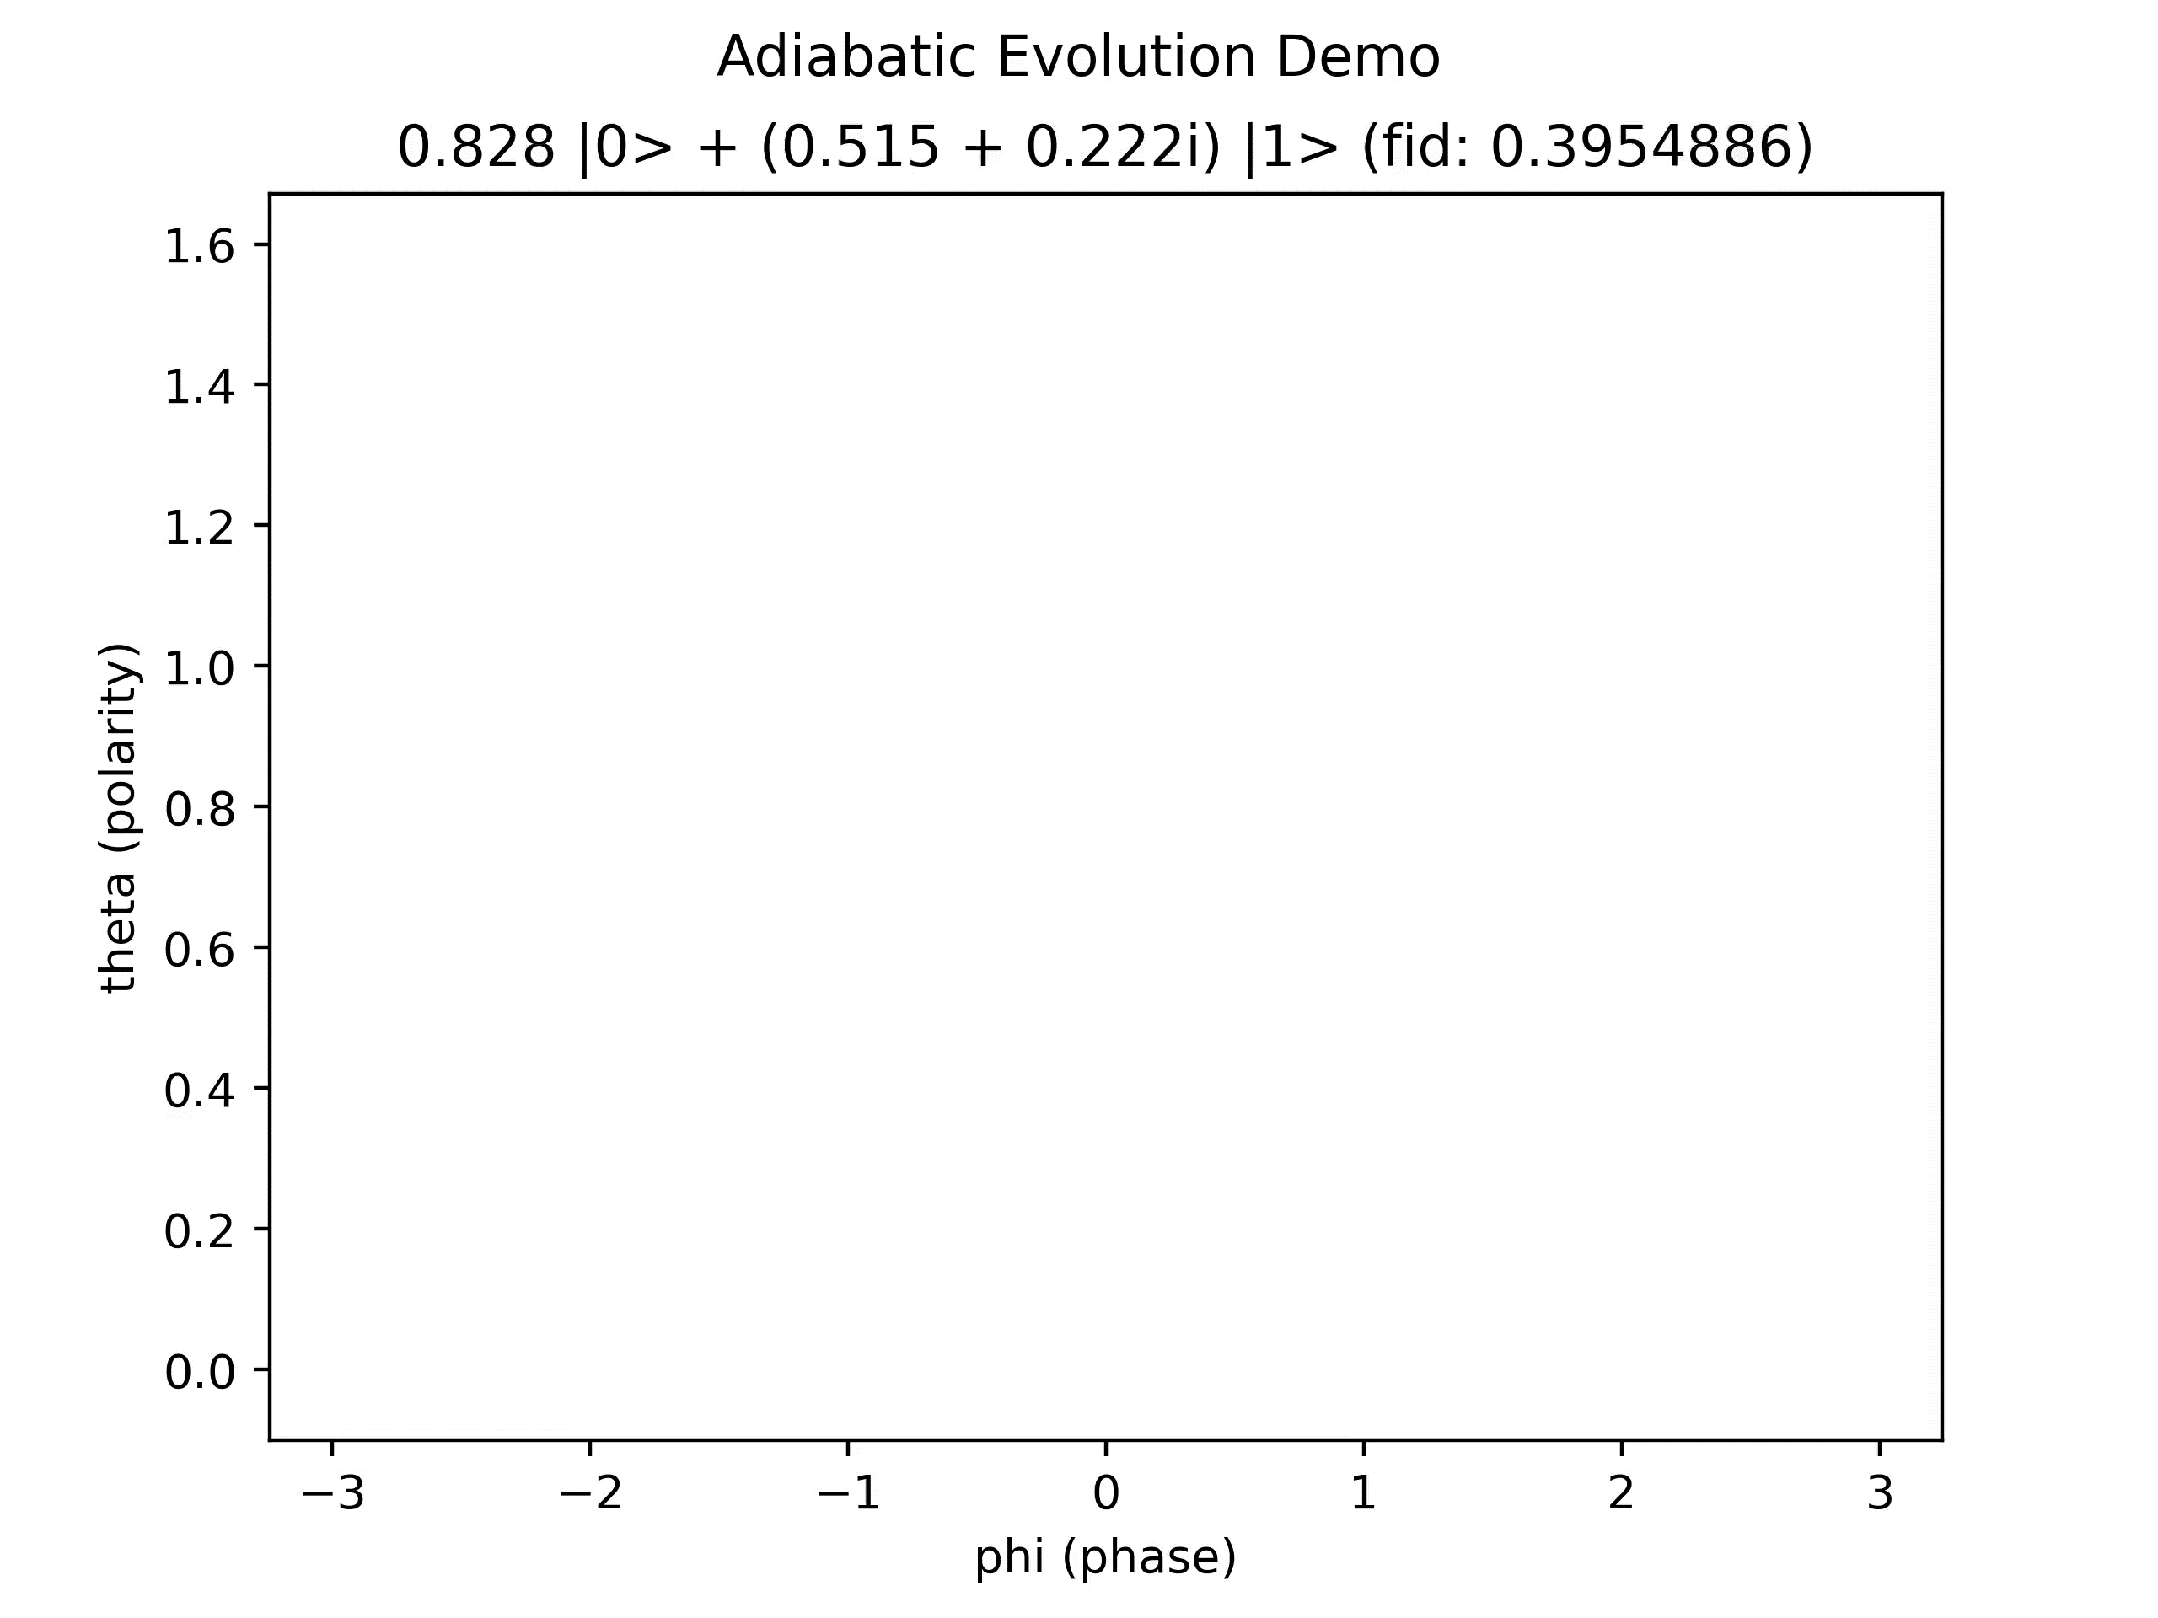
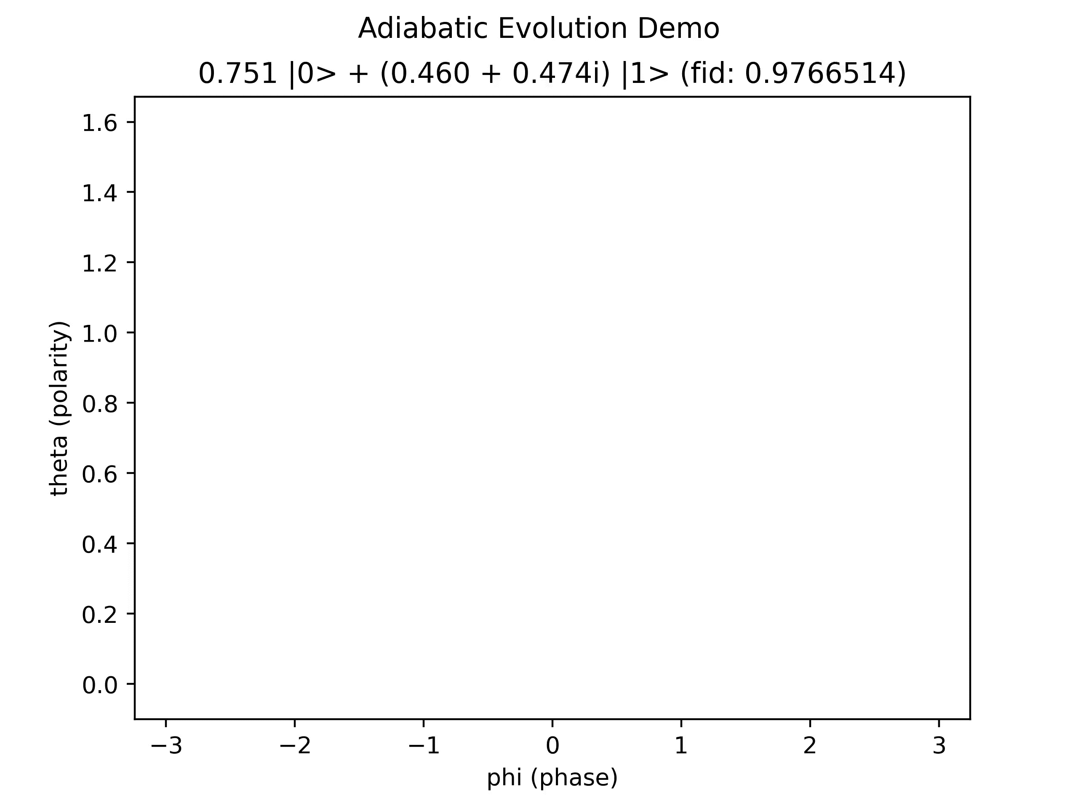
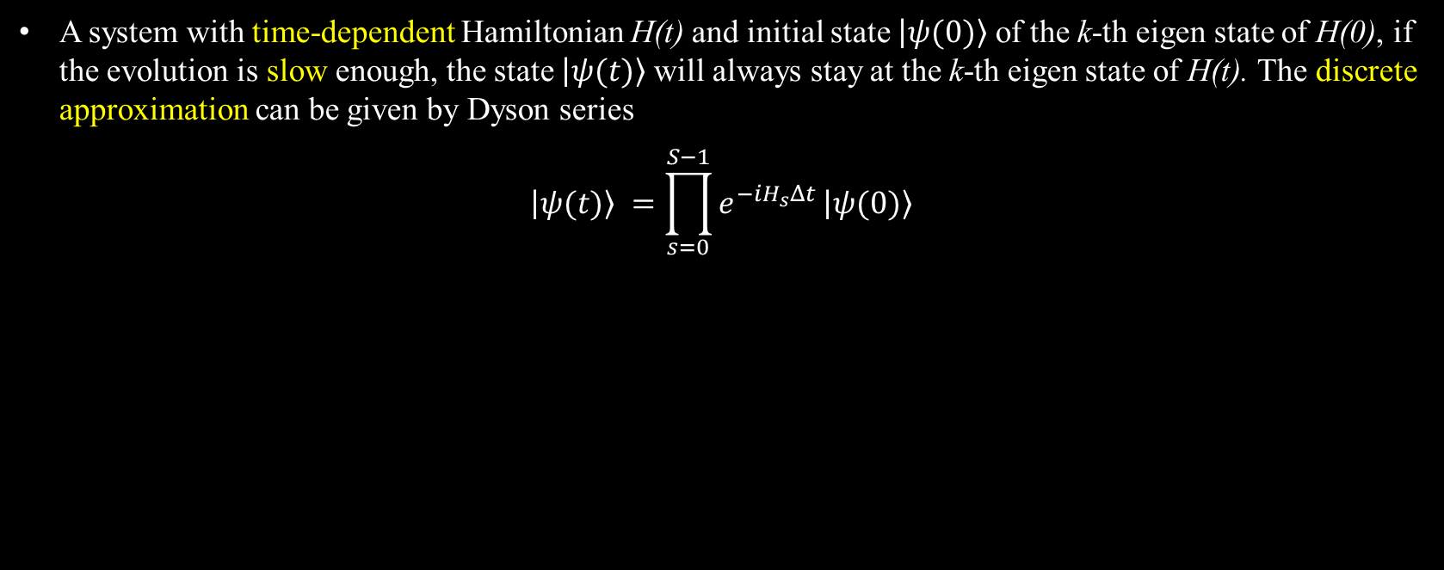
Adiabatic Evolution
A system with time-dependent Hamiltonian H(t) and initial state $\left|ψ(0)\right\rangle$ of the k-th eigen state of H(0), if the evolution is slow enough, the state $\left|ψ(t)\right\rangle$will always stay at the k-th eigen state of H(t). The discrete approximation can be given by Dyson series
$$\left|ψ(t)\right\rangle =\prod_{s=0}^{S−1}{e^{−iH_{s}Δt}}⁡\left|ψ(0)\right\rangle$$
Fast
Slow
Notes:
https://en.wikipedia.org/wiki/Adiabatic_theorem

Slide 6
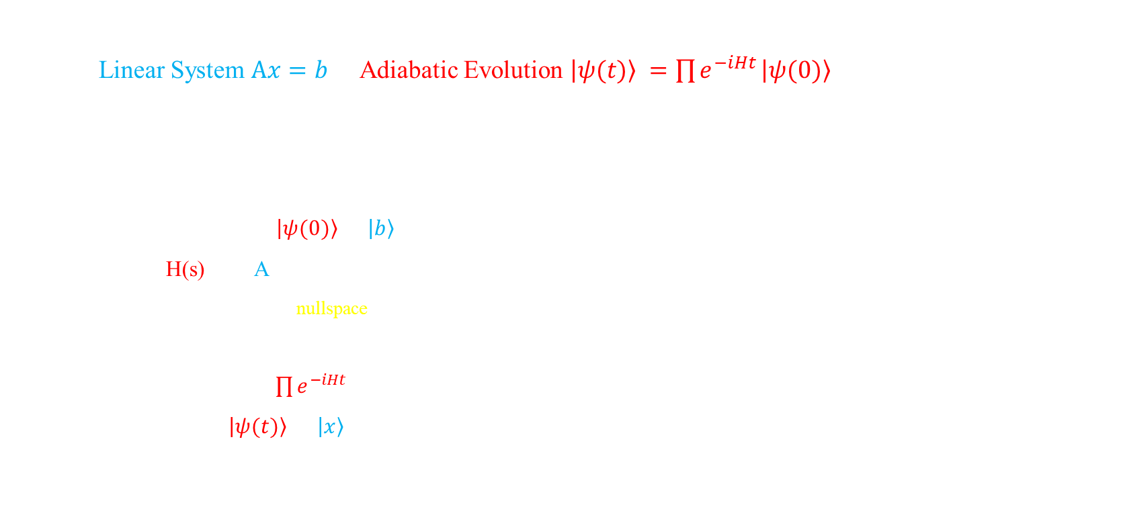

General Procedure of Adiabatic Linear Solver
Map Linear System $Ax=b$ to Adiabatic Evolution $\left|ψ(t)\right\rangle =\prod{e^{−iHt}}⁡\left|ψ(0)\right\rangle$
Pre-transformation
A is positive definite, with spectral norm ${||A||}_{2}≤1$
b is normalized to unit vector
Prepare initial state $\left|ψ(0)\right\rangle =\left|b\right\rangle$
Design H(s) w.r.t A
$\left|b\right\rangle$ and $\left|x\right\rangle$ are the nullspace vectors of $H_{0}$ and $H_{1}$
H(s) is a scheduled mixture of $H_{0}$ and $H_{1}$
Perform evolutions $\prod{e^{−iHt}}$
Get final state $\left|ψ(t)\right\rangle =\left|x\right\rangle$
Practically, need some ancilla qubits to complete
For example $A=\left[\begin{matrix}2 & 1 \\ 1 & 0\end{matrix}\right],b=\left[\begin{matrix}3 \\ 1\end{matrix}\right]$
Let $\tilde{A}=\frac{A^{†}A}{\left|A^{†}b\right|},\tilde{b}=\frac{A^{†}b}{|A^{†}b|}$ to satisfy conditions
Follow arXiv:1805.10549, define:
$$f(s): [0, 1]→[0, 1]$$
$$A(s) = (1−f(s))⋅I + f(s) ⋅\tilde{A}$$
$H(s)=$ $A(s) ⋅(I−|\tilde{b}⟩⟨\tilde{b}|)⋅A(s)$
st. $H\left(0\right)\left|b\right\rangle =H(1)\left|x\right\rangle =0$
With $H\left(s\right)$ where $s:0→1$ we’ll also have $\left|b\right\rangle →\left|x\right\rangle$

Slide 7
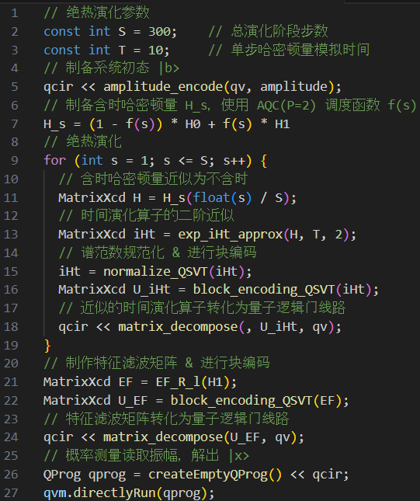

Implementation Techniques
Time evolution operator
Hamiltonian Simulation
Block Encoding
Adiabatic evolution control
Logical step: schedule function $f(s)$
Physical time: randomization method
Quest for more precision
Eigenvalue Filtering
pseudo-code for our LS impl.

Slide 8
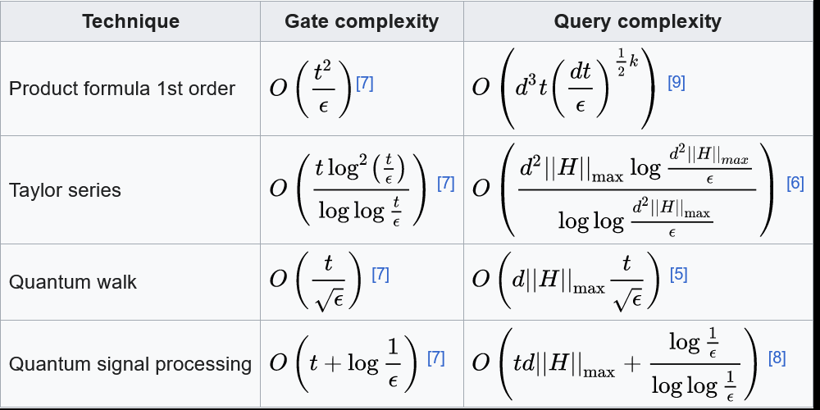

Hamiltonian Simulation
Implement time evolution operator $e^{−iHt}$ in quantum circuit
Techniques
Trotterization
$e^{−i(A+B)t}=\lim_{r→∞}{{(e^{−i\frac{A}{r}t}e^{−i\frac{B}{r}t})}^{r}}$
Taylor approx.
$e^{−iHt}=\sum_{k}{\frac{{(−iHt)}^{k}}{k!}}≈I−iHt$, then block encode
Quantum Walk
Quantum Signal Processing
So-far the optimal way ⭐
https://en.wikipedia.org/wiki/Hamiltonian_simulation

Slide 9
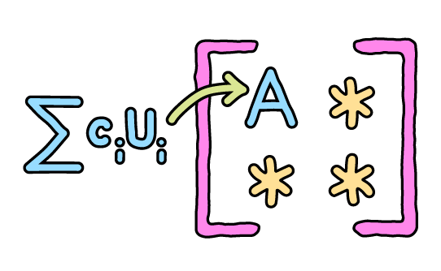
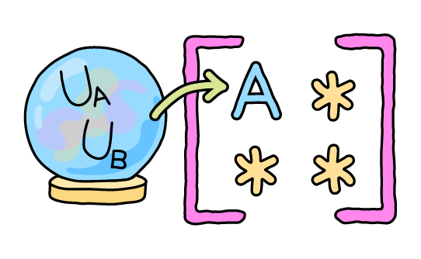
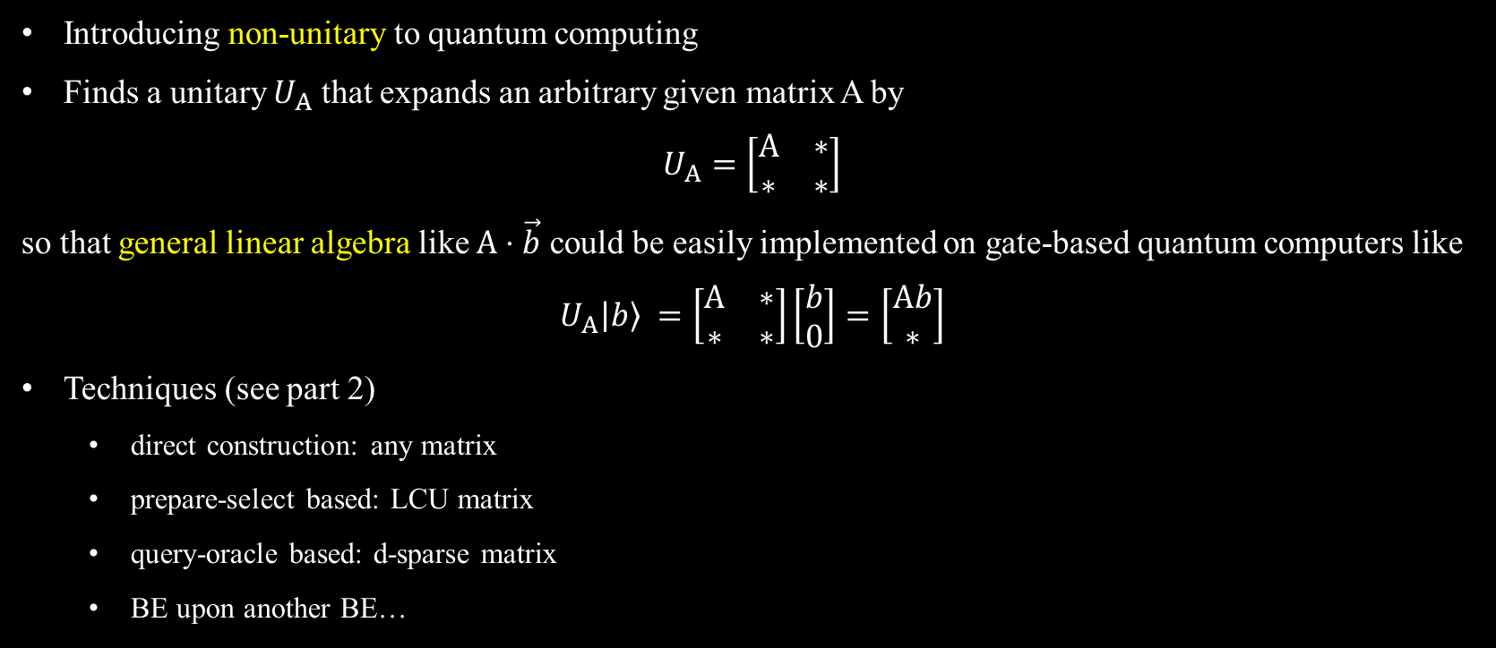
Block Encoding (arXiv:2402.17529)
Introducing non-unitary to quantum computing
Finds a unitary $U_{A}$ that expands an arbitrary given matrix A by
$$U_{A}=\left[\begin{matrix}A & ∗ \\ ∗ & ∗\end{matrix}\right]$$
so that general linear algebra like $A⋅\vec{b}$ could be easily implemented on gate-based quantum computers like
$$U_{A}\left|b\right\rangle =\left[\begin{matrix}A & ∗ \\ ∗ & ∗\end{matrix}\right]\left[\begin{matrix}b \\ 0\end{matrix}\right]=\left[\begin{matrix}Ab \\ ∗\end{matrix}\right]$$
Techniques (see part 2)
direct construction: any matrix
prepare-select based: LCU matrix
query-oracle based: d-sparse matrix
BE upon another BE…
https://pennylane.ai/qml/demos/tutorial_lcu_blockencoding
https://pennylane.ai/qml/demos/tutorial_block_encoding

Slide 10
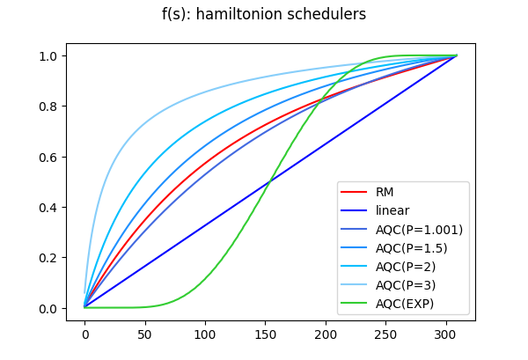


Schedule Function & Randomizatiom Method (arXiv:1909.05500) (arXiv:1805.10549)
Hamiltonian schedule: s in H(s)
$f(s): [0, 1]→[0, 1]$
$H\left(s\right)=\left(1−f(s)\right)⋅H_{0}+f(s)⋅H_{1}$
Principle: $f\left(s\right)↑, f^{′}(s)↓$
Evolution time schedule: t in $e^{−iHt}$
constant: $t = T / S$
randomized: $t ∼U[0, 2πΔ^{∗}]$
$Δ^{∗}\left(s\right)=1−f\left(s\right)+f(s)/κ$
$κ$ is the condition number of A
Logical step
s=0
s=$\frac{1}{200}$
……
s=1.0
Physical time
T=0
T=5
……
T=1000

Slide 11
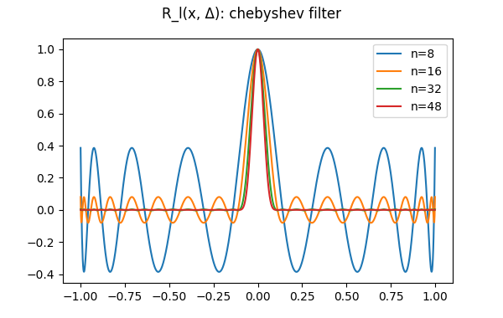
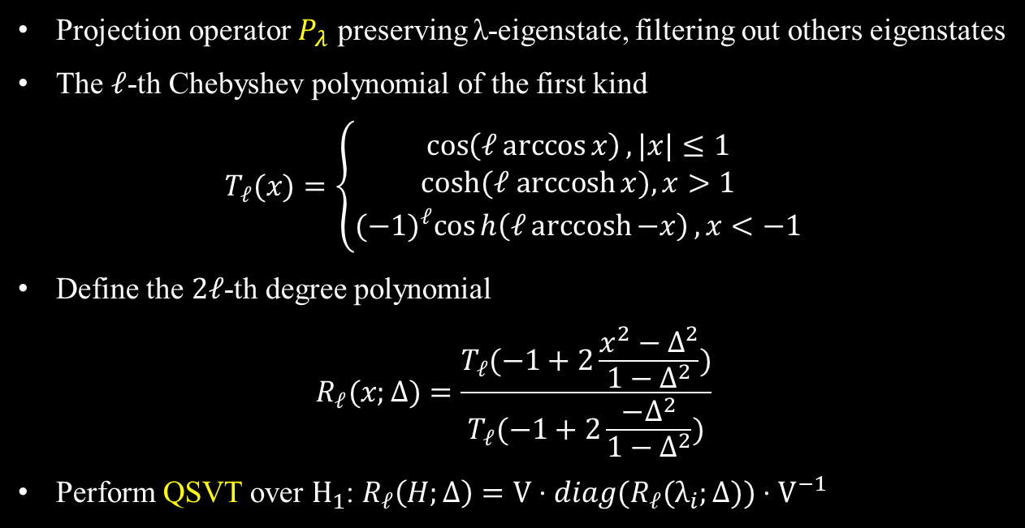
Eigenvalue Filtering (arXiv:1910.14596)
Projection operator $P_{λ}$ preserving λ-eigenstate, filtering out others eigenstates
The $ℓ$-th Chebyshev polynomial of the first kind
$$T_{ℓ}(x)=\left\{\begin{aligned}\cos\left(ℓ\arccos{x}\right), |x|≤1 \\ cosh⁡(ℓ arccosh⁡x), x>1 \\ {(−1)}^{ℓ}\cos{h\left(ℓ\operatorname{arccosh}{−x}\right)}, x<−1\end{aligned}\right.$$
Define the $2ℓ$-th degree polynomial
$$R_{ℓ}(x;Δ)=\frac{T_{ℓ}(−1+2\frac{x^{2}−Δ^{2}}{1−Δ^{2}})}{T_{ℓ}(−1+2\frac{−Δ^{2}}{1−Δ^{2}})}$$
Perform QSVT over $H_{1}$: $R_{ℓ}\left(H;Δ\right)=V⋅diag(R_{ℓ}(λ_{i};Δ))⋅V^{−1}$

Slide 12
Solutions to the Contest Problem
Part 2

Slide 13
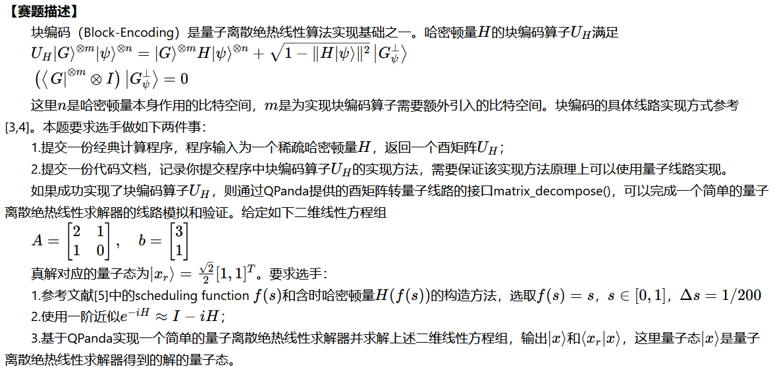
Problem Description

Slide 14
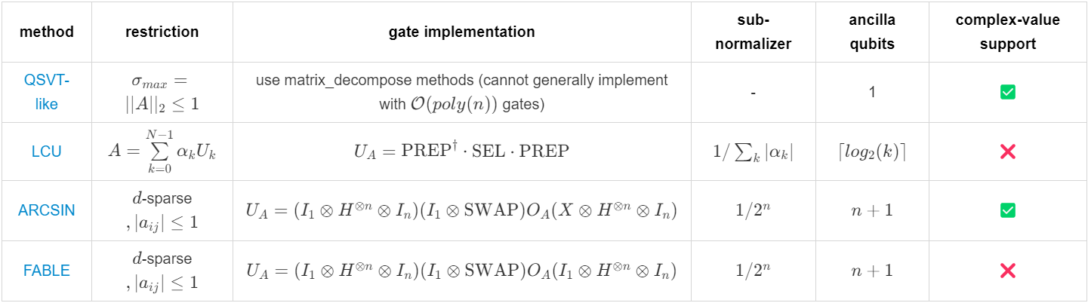
Task 1: Implementing the Block Encoding
我们实现了 4 种不同的块编码算法
以 QSVT 方法为第一题的最终提交

Slide 15

Block Encoding: QSVT-like (arXiv:2203.10236)
对任意形状的复矩阵A，满足谱范数 ${||A||}_{2}≤1$ ，直接构造如下矩阵
$$U_{A}=\left[\begin{matrix}A & \sqrt{I−AA^{†}} \\ \sqrt{I−A^{†}A} & −A^{†}\end{matrix}\right]$$
其中 $\sqrt{∙}$ 定义为矩阵开根运算，即在 A 的特征分解中对谱系数分别开根
$$\sqrt{A}= V\sqrt{D}V^{−1}= V⋅diag(\sqrt{λ_{i}})⋅V^{−1}$$
易验证 $U_{A}$ 为A的一个 (λ=1,m=1,ε=0)-块编码
$U_{A}$ 满足酉性 ${U_{A}}^{†}U_{A}=I$，且A出现在其左上角的子空间
缩放因子 λ=1；辅助比特数 m=1；误差 ε=0
当A不满足谱范数条件时，可以转而考虑对规范化后的 $\tilde{A}=\frac{A}{{||A||}_{2}}$ 作块编码
$U_{A}$ 的逻辑门线路可以借助 QR/CSD/QSD 等矩阵分解技术实现
Notes:
https://pennylane.ai/qml/demos/tutorial_intro_qsvt

Slide 16
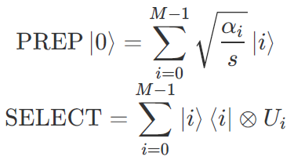
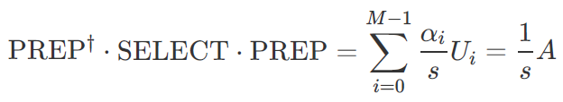
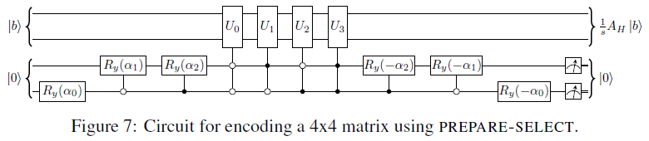

Block Encoding: LCU (arXiv:1202.5822)
若复方阵A可以分解为若干酉阵的线性和，即存在 $A=\sum_{i=0}^{M−1}{α_{i}U_{i}}$
则可以通过下述 PREPARE-SELECT 结构的线路对A进行块编码
PREP: 振幅编码提供各项对应的系数 $α_{i}$
SEL: 控制比特按位序和门控条件来选择各项对应的酉矩阵 $U_{i}$
易验证该线路所对应的酉矩阵 $U_{A}$ 为A的一个 (λ= 1/$\sum_{i=0}^{M−1}{|α_{i}|}$,m=$\left\lceil \log_{2}⁡(M)\right\rceil$,ε)-块编码
缩放因子 λ=1/s 来源于振幅编码时的概率归一化
引入的 m 个辅助比特用于 PREP 线路
误差 ε 取决于舍去小项的系数
Notes:
https://pennylane.ai/qml/demos/tutorial_lcu_blockencoding

Slide 17
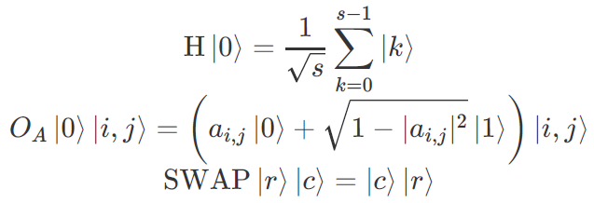
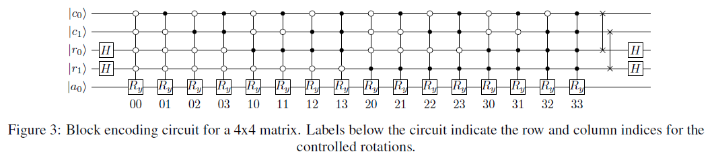
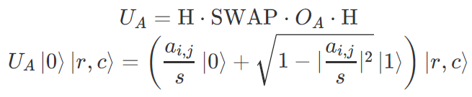

Block Encoding: ARCCOS (arXiv:2402.17529)
若复方阵A为 d-稀疏矩阵，则可以通过下述 query-oracle 结构的线路对A进行块编码
易验证该线路所对应的酉矩阵 $U_{A}$ 为A的一个 (λ= $\frac{1}{2^{N}}$,m=N,ε)-块编码
N为原矩阵A的行/列数
缩放因子 λ=1/s 来源于哈达玛打散时的振幅均一化
引入的 m 个辅助比特用于行列索引

Slide 18
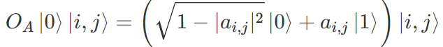
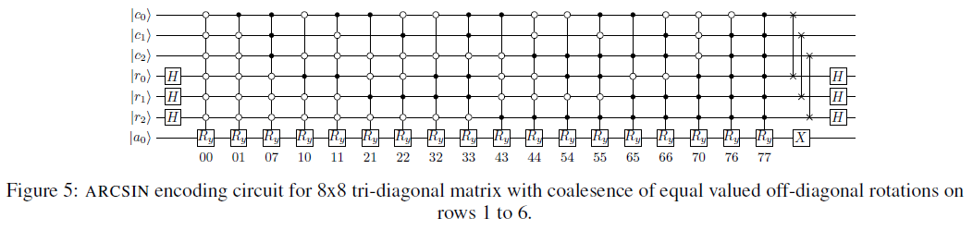

Block Encoding: ARCSIN (arXiv:2402.17529)
考虑到稀疏矩阵中存在大量0，将 arccos 改为 arcsin 编码以消除旋转角度为 arccos(π/2) 的项
辅助比特线路末尾引入X门
块编码参数 (λ= $\frac{1}{2^{N}}$,m=N,ε) 与 ARCCOS 一致

Slide 19
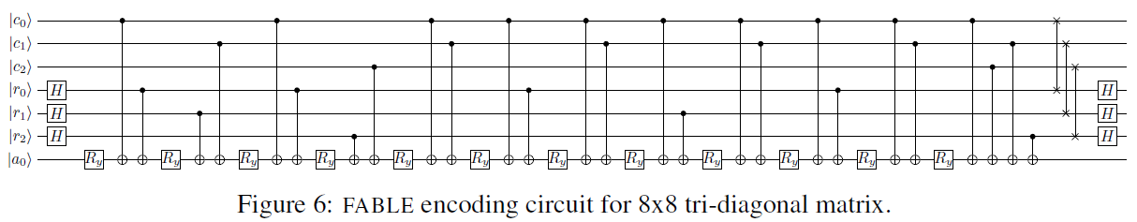

Block Encoding: FABLE (arXiv:2402.17529)
同样基于 query-oracle 框架，适用于d-稀疏矩阵，通过一些技术进行了线路深度压缩
对易的多比特控制门进行对消
格雷码编码：连续的旋转门进行角度合并
块编码参数 (λ= $\frac{1}{2^{N}}$,m=N,ε) 与 ARCCOS 一致

Slide 20
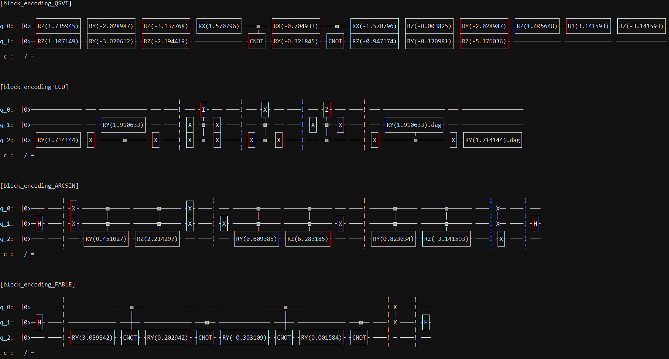
Demo cases of
our implementation

Slide 21
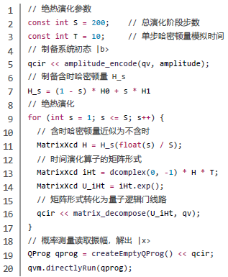
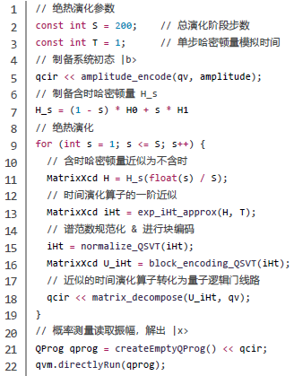
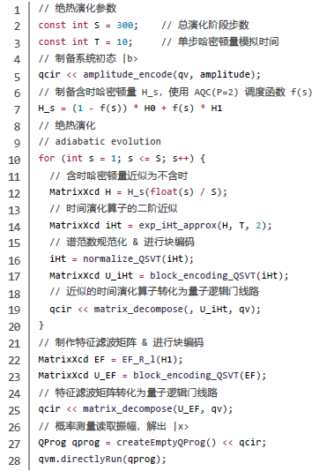
Task 2: Implementing the Linear Solver
ideal
contest-specified
ours

Slide 22
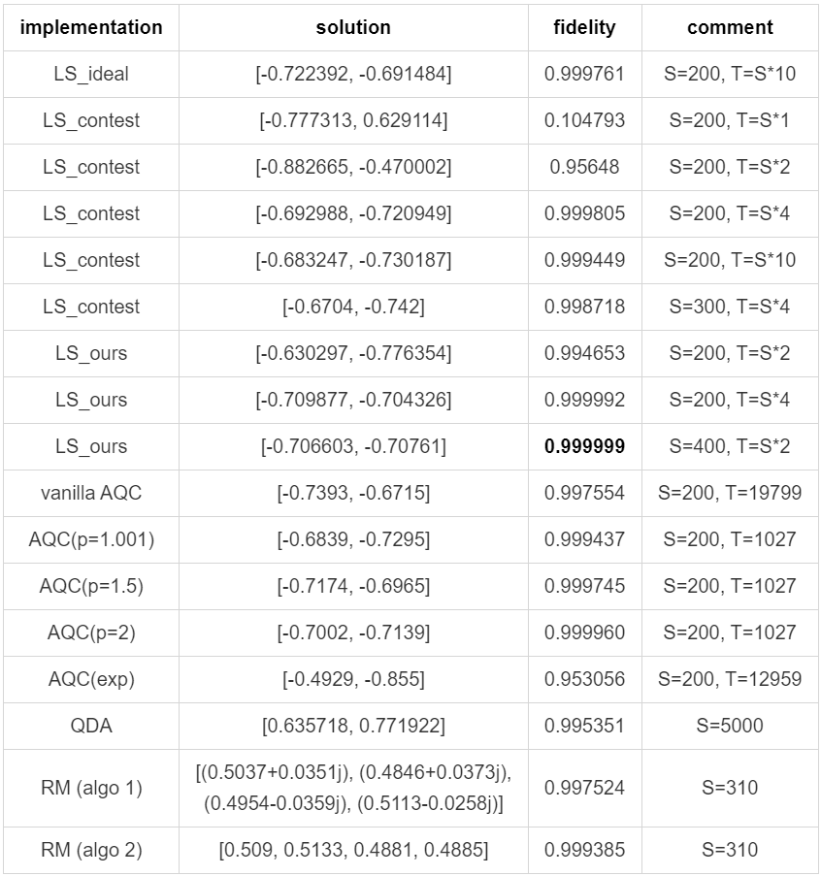
Numerical Results
RM & AQC as baseline
QDA leave to discuss
LS as our final submission
ideal: TE ideal + linear
contest: TE approx. BE + linear
ours: TE approx. BE + AQC(P=2) + EF
Precision reference
RM for ε = 0.01
N=16, κ ≈ 10 → S ≈ 500
N=32, κ ≈ 50 → S ≈ 1000
AQC(2) for ε = 0.001
κ = 20 → T ≈ 200

Slide 23
Error Analysis
Impact factor: schedule f(s) > TE approx. > steps S > time T

Slide 24
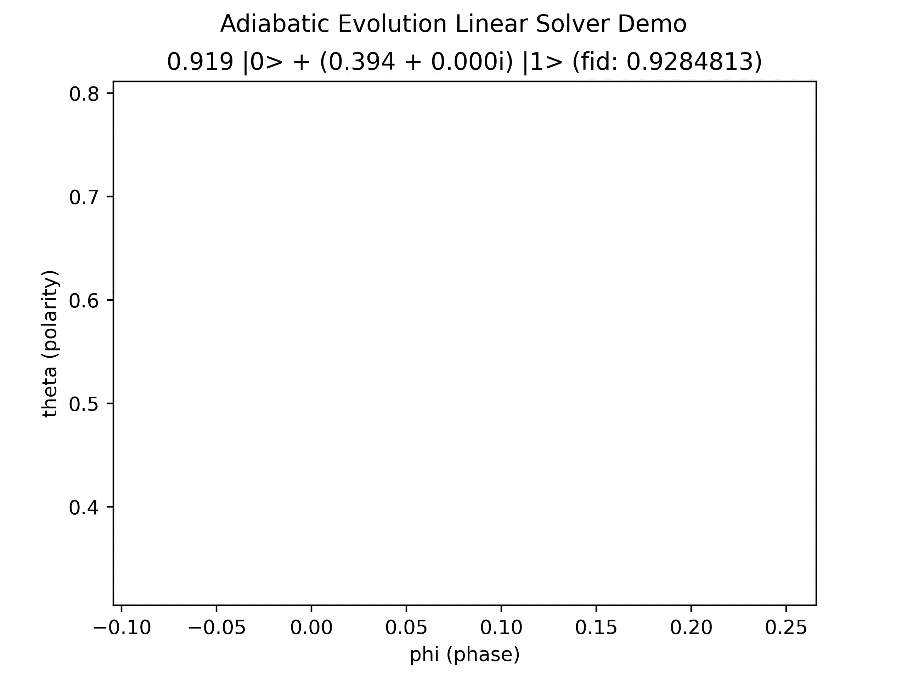
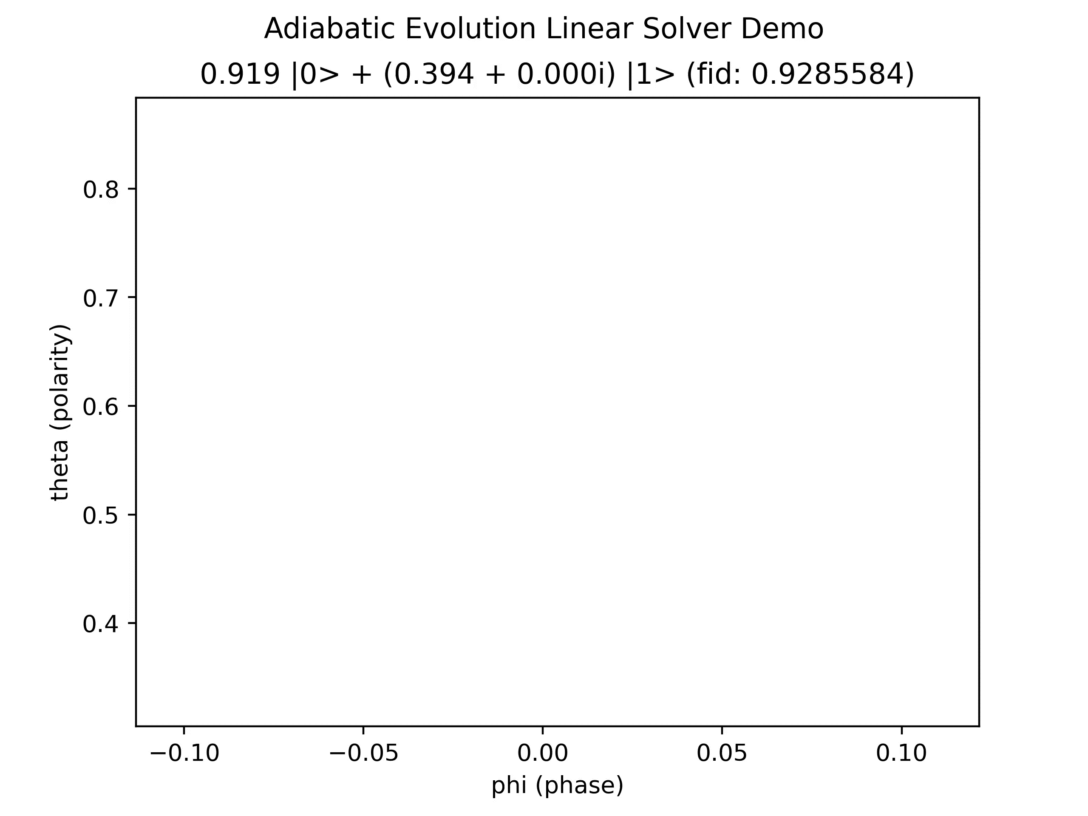
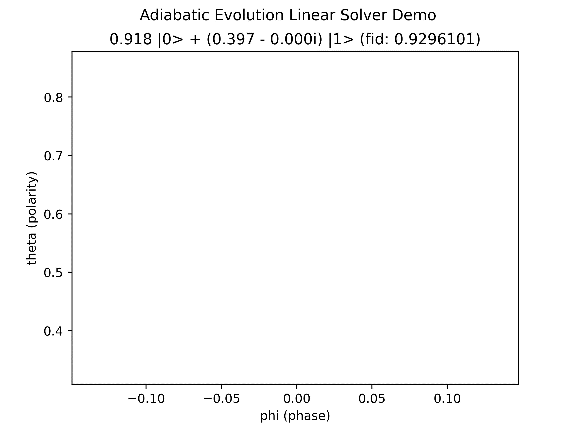
Visualize the Adiabatic Solver Solutions
These are NOT exactly our LS implementations, but simplified version just for concept sketch
phase shift may be caused by floating-point error, temporarily ignored…
S=1000
f=linear
S=1000
f=poly(2.0)
S=200
f=poly(2.0)

Slide 25
Rethinkings 🤔
Part 3

Slide 26
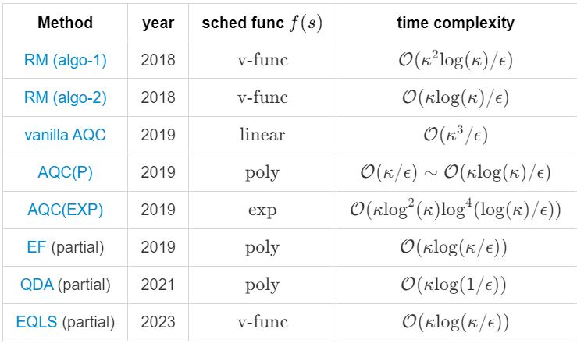
The Linear Solver “Losers” in Complexity Race
RM: randomized evolution time
predictable running time
loyal error bound
AQC(P/EXP): time-optimal f(s) schedule
AQC really better than RM v-func?
QEF = AQC(P) + EF (via QSVT)
QDA = AQC(P) + QWalk + EF (via LCU)
QWalk really better than Dyson series?
EQLS = RM + EF
nothing new, but you might be the wise 😮
Literature Chronicle
Notes:
红色：感觉实际上有些问题
黄色：我们的实验表明确实有效

Slide 27
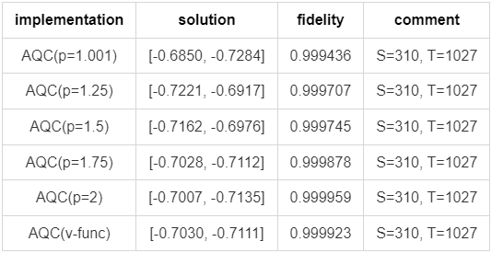
The AQC Myths (arXiv:1909.05500)
AQC(P) ~ RM v-func
Note that fidelity also counts for ancillas, in this case
AQC(v-func) gives a slight better results than AQC(p=2)

Slide 28
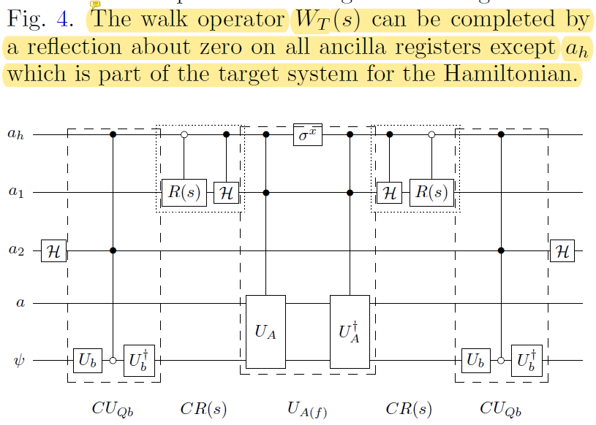
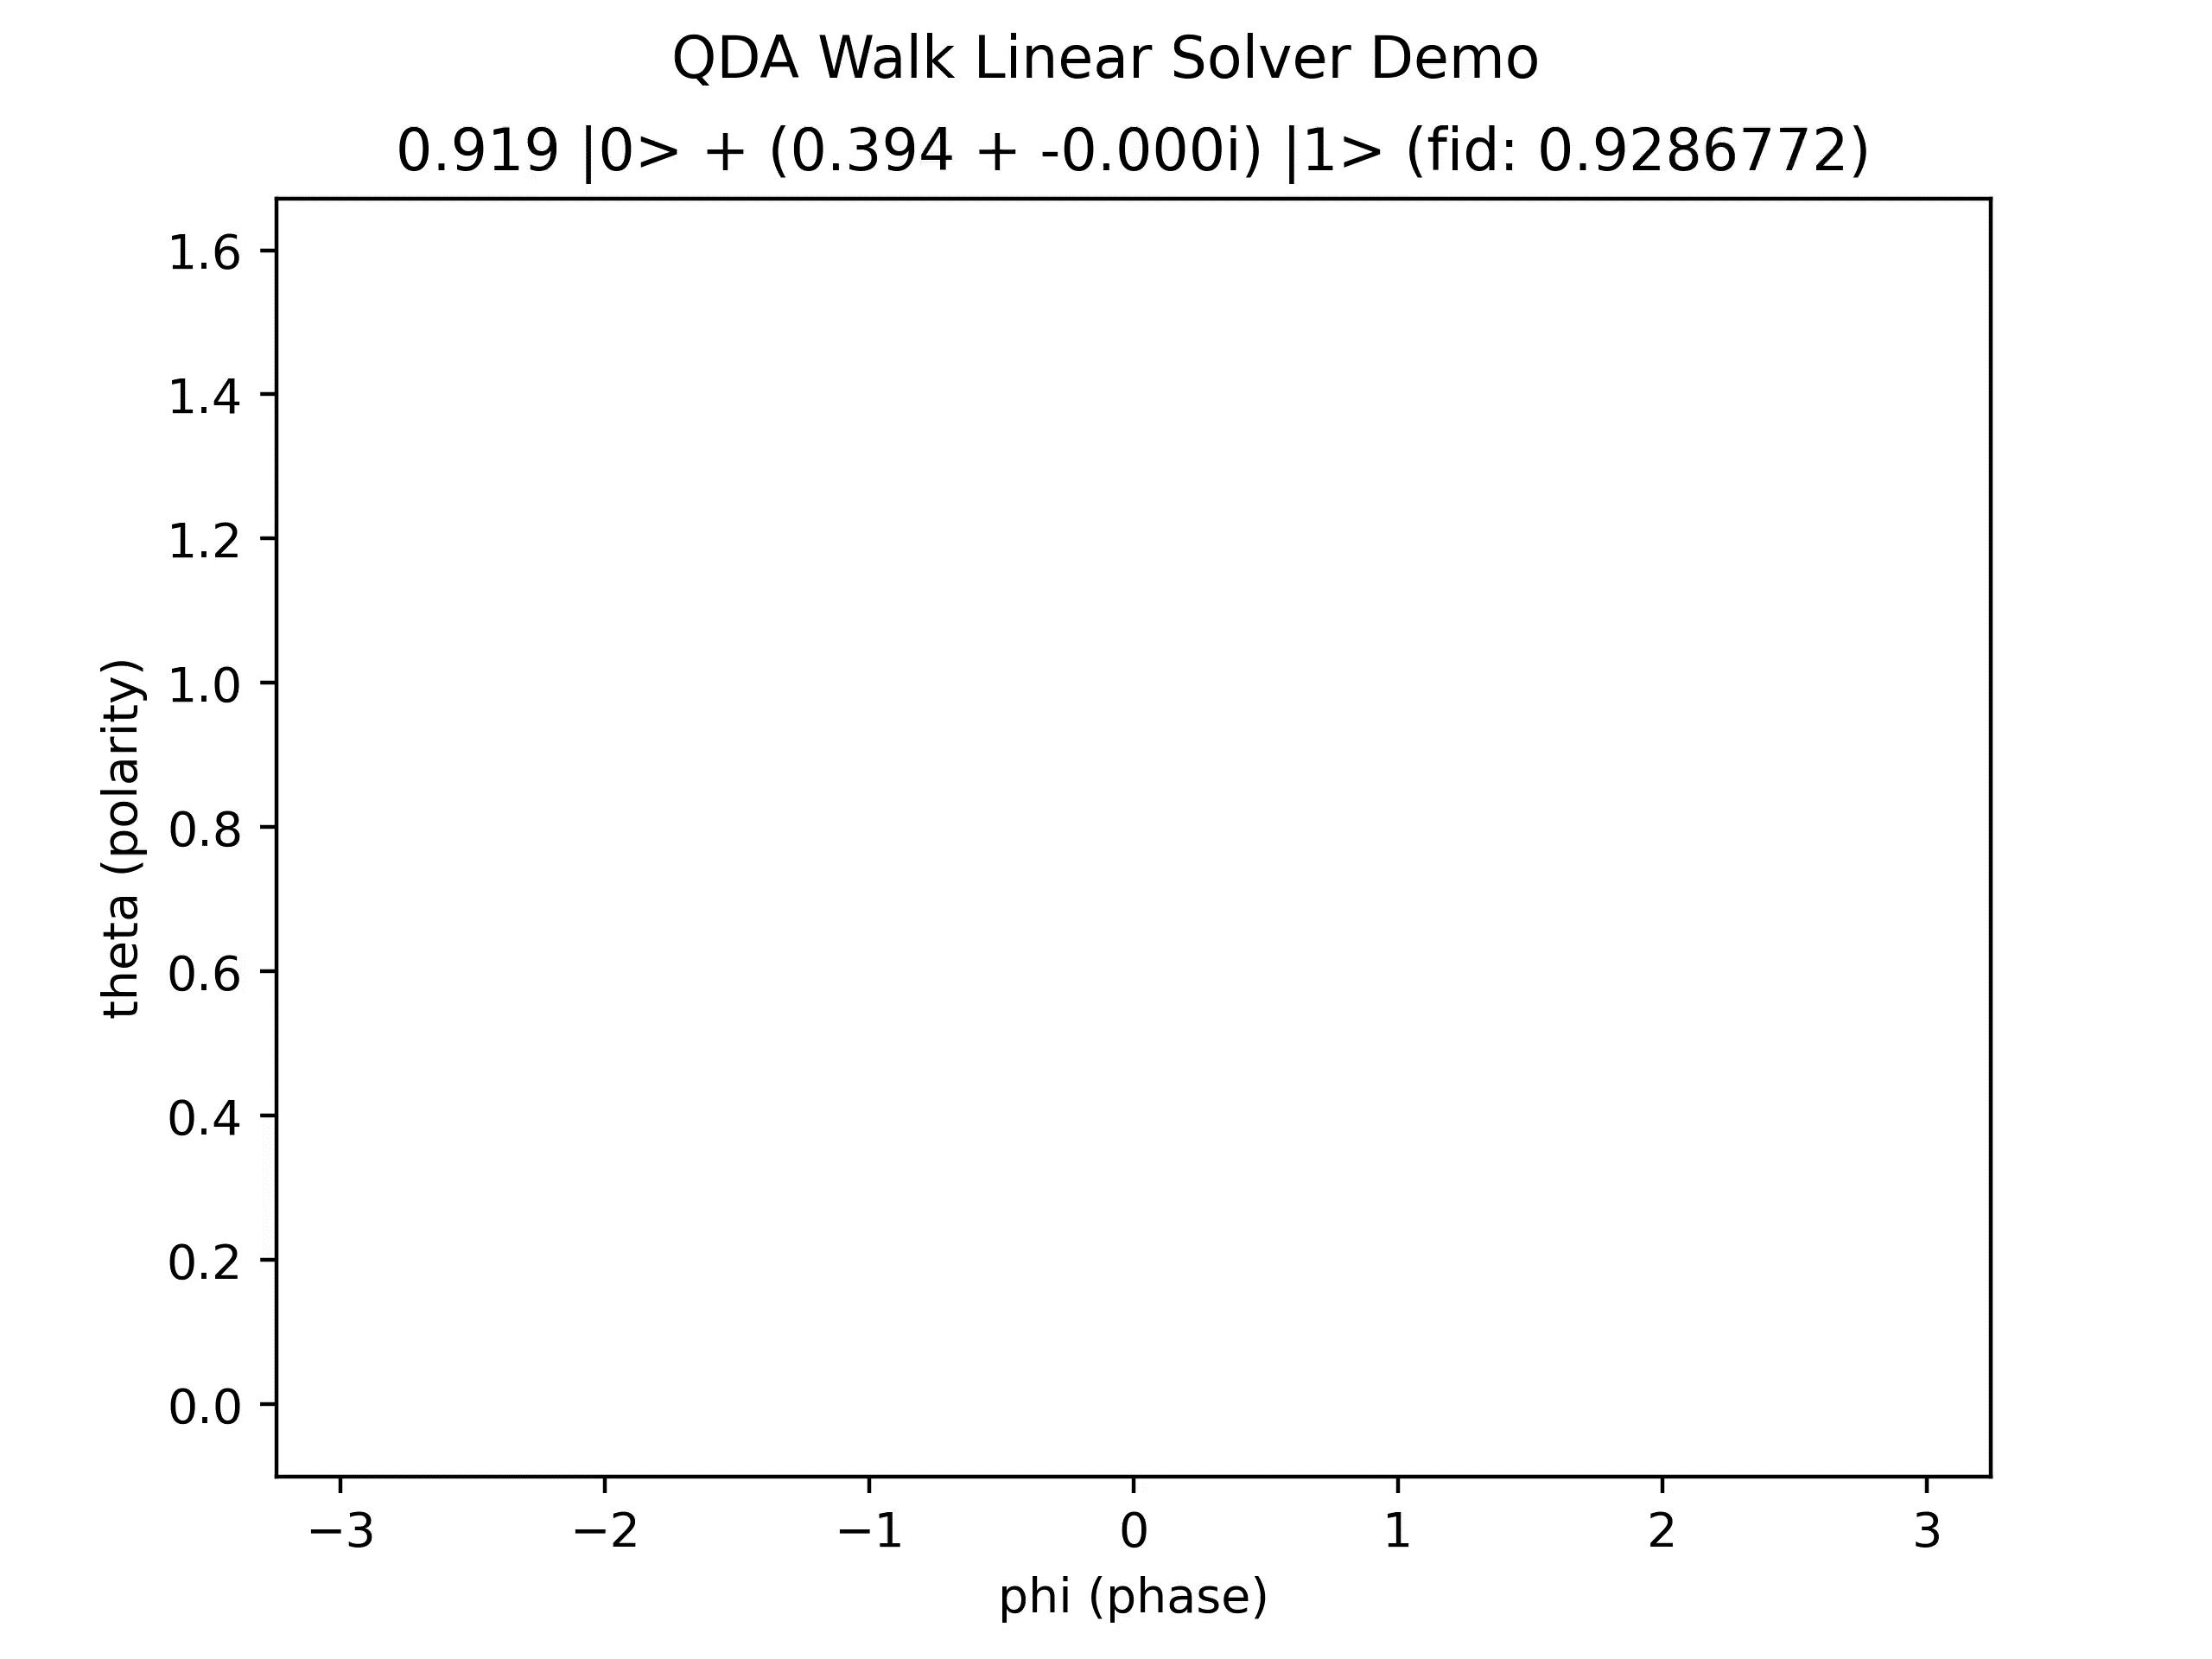
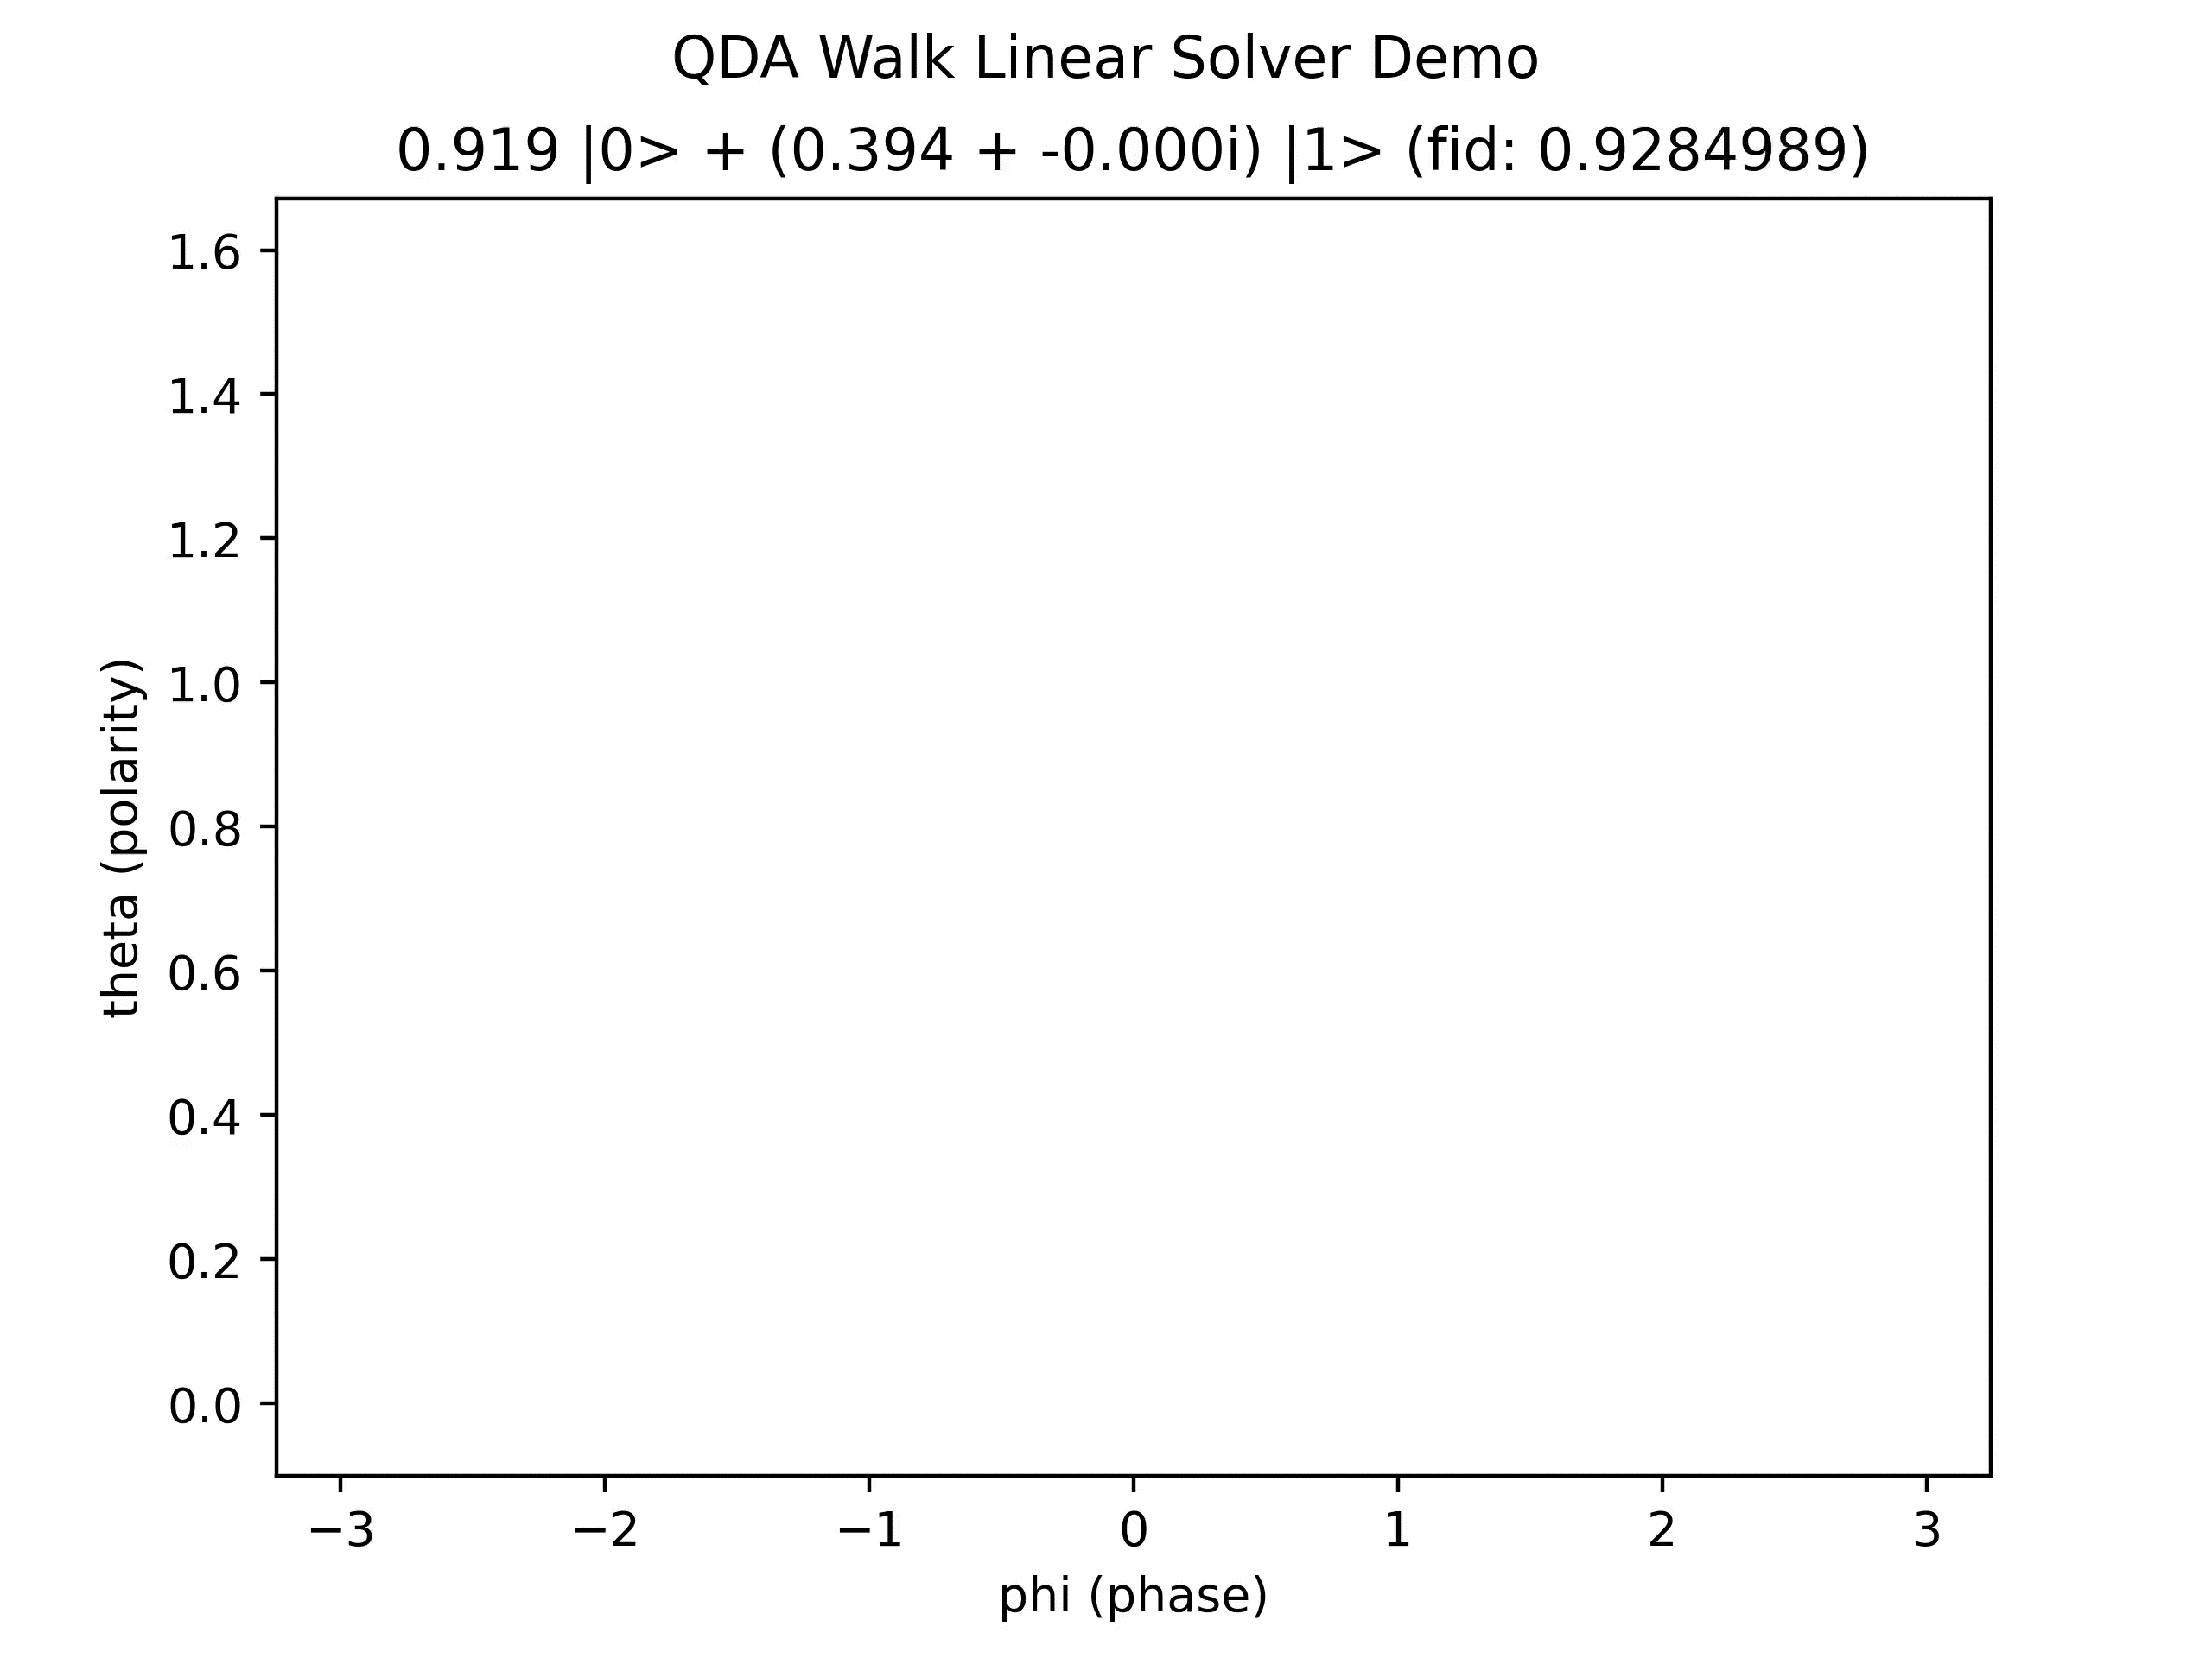
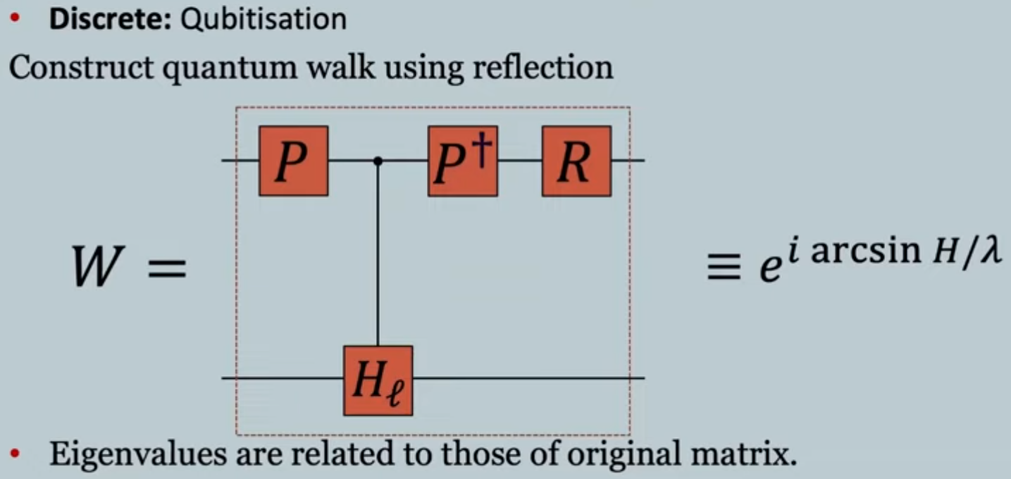
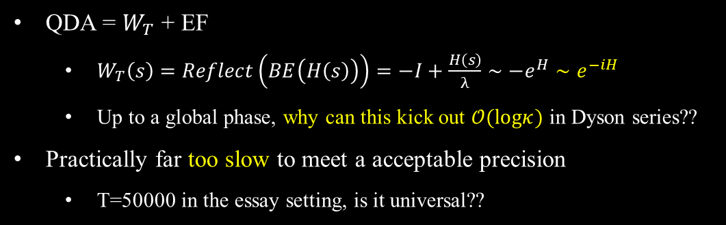
The QDA Myths (arXiv:2111.08152/2312.07690)
QDA = $W_{T}$ + EF
$W_{T}\left(s\right)=Reflect\left(BE\left(H\left(s\right)\right)\right)=−I+\frac{H\left(s\right)}{λ}∼−e^{H}∼e^{−iH}$
Up to a global phase, why can this kick out $𝒪(logκ)$ in Dyson series??
Practically far too slow to meet a acceptable precision
T=50000 in the essay setting, is it universal??
BE upon another BE
T=500
T=5000
https://www.youtube.com/watch?v=WfByvOf3N3Y

Slide 29
Core References
[RM] Quantum algorithms for systems of linear equations inspired by adiabatic quantum computing (arXiv:1805.10549)
[AQC] Quantum linear system solver based on time-optimal adiabatic quantum computing and quantum approximate optimization algorithm (arXiv:1909.05500)
[EF] Optimal polynomial based quantum eigenstate filtering with application to solving quantum linear systems (arXiv:1910.14596)
[QDA] Optimal scaling quantum linear systems solver via discrete adiabatic theorem (arXiv:2111.08152)
[EQLS]Efficient quantum linear solver algorithm with detailed running costs (arXiv:2305.11352)
https://pennylane.ai/qml/demos/tutorial_intro_qsvt/
https://pennylane.ai/qml/demos/tutorial_lcu_blockencoding/
https://pennylane.ai/qml/demos/tutorial_block_encoding/
FABLE: Fast Approximate Quantum Circuits for Block-Encodings (arXiv:2205.00081)
Evaluation of block encoding for sparse matrix inversion using QSVT (arXiv:2402.17529)

Slide 30
Citation
Github: https://github.com/Kahsolt/Adiabatic-Linear-Solver-QPanda
If you find this work useful, please give us a star ⭐ and cite~
@misc{kahsolt2024,
author = {Kahsolt},
title = {Adiabatic Linear Solver QPanda},
howpublished = {\url{https://github.com/Kahsolt/Adiabatic-Linear-Solver-QPanda}}
month = {June},
year = {2024}
}

Slide 31
Thanks for your watching 🎉

